Slide 1

Wireless communication for dummies
Lorenzo Maggi, lorenzo.maggi@nokia-bell-labs.com
Nokia Bell Labs
Source: Tse, D., & Viswanath, P. (2005). Fundamentals of wireless communication.
Cambridge university press.
Network theory reading group @LINCS

Slide 2
Part 1: Communication channel
March 16, 2022

Slide 3
Goal for today
Understand from basic principles
Where do complex signals come from
Meaning of
  “Channel” / “Channel response”
  “Fading” (slow/fast/flat)
  “Coherence time”
  “Doppler spread”
  “Delay spread”
  “Coherence bandwidth”
  “Inter-symbol interference”
  “Baseband”

Slide 4
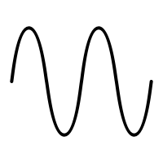


Wavelength, frequency and speed
$$λ=c/f$$
Speed $c=\frac{\left(distance between two peaks\right)}{(time interval between two peaks)}=\frac{λ}{T}=λf$

Slide 5


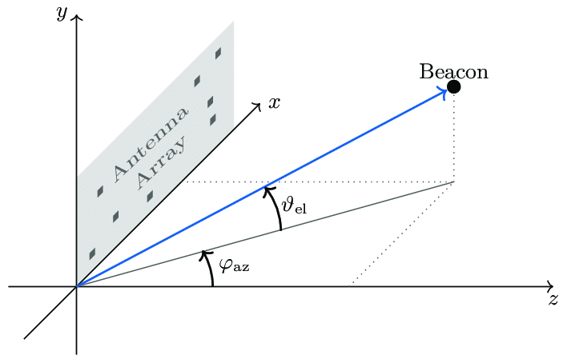

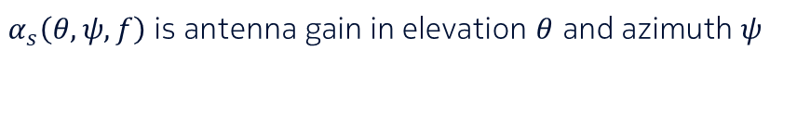

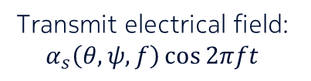


Free space, fixed rx antenna
Transmit electrical field: $α_{s}\left(θ,ψ,f\right)\cos{2πft}$
Receive: $\frac{α_{s}\left(θ,ψ,f\right)\cos{2πf\left(t−\frac{r}{c}\right)}}{r}$
Distance $r$
Propagation delay $\frac{r}{c}$
$α_{s}\left(θ,ψ,f\right)$ is antenna gain in elevation $θ$ and azimuth $ψ$
Elevation $θ$
Azimuth $ψ$

Slide 6
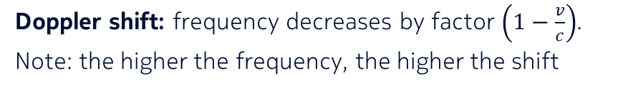

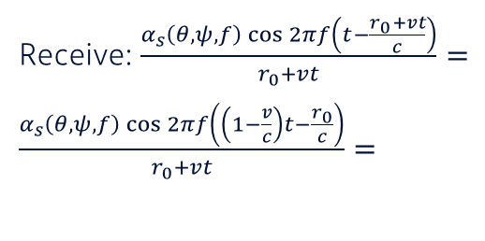
Free space, moving rx antenna
Receive: $\frac{α_{s}\left(θ,ψ,f\right)\cos{2πf\left(t−\frac{r_{0}+vt}{c}\right)}}{r_{0}+vt}=$
$\frac{α_{s}\left(θ,ψ,f\right)\cos{2πf\left(\left(1−\frac{v}{c}\right)t−\frac{r_{0}}{c}\right)}}{r_{0}+vt}=$
Transmit electrical field: $α_{s}\left(θ,ψ,f\right)\cos{2πft}$
Distance $r_{0}+vt$
Propagation delay $\frac{r_{0}+vt}{c}$
Doppler shift: frequency decreases by factor $\left(1−\frac{v}{c}\right)$.
Note: the higher the frequency, the higher the shift

Slide 7


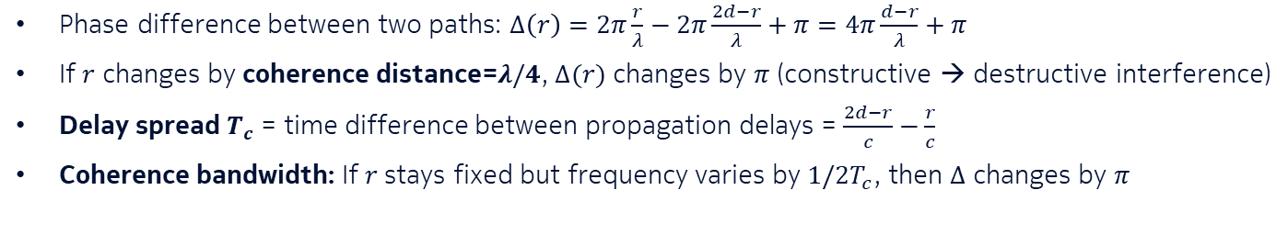

Reflecting wall, fixed rx antenna
Sign inversion due to reflection
Transmit electrical field: $α\cos{2πft}$
Receive: $\frac{α\cos{2πf\left(t−\frac{r}{c}\right)}}{r}−\frac{α\cos{2πf\left(t−\frac{2d−r}{c}\right)}}{2d−r}$
$$r$$
$$d$$
Phase difference between two paths: $Δ\left(r\right)=2π\frac{r}{λ}−2π\frac{2d−r}{λ}+π=4π\frac{d−r}{λ}+π$
If $r$ changes by coherence distance=$λ/4$, $Δ(r)$ changes by $π$ (constructive → destructive interference)
Delay spread $T_{c}$ = time difference between propagation delays = $\frac{2d−r}{c}−\frac{r}{c}$
Coherence bandwidth: If $r$ stays fixed but frequency varies by $1/2T_{c}$, then $Δ$ changes by $π$

Slide 8
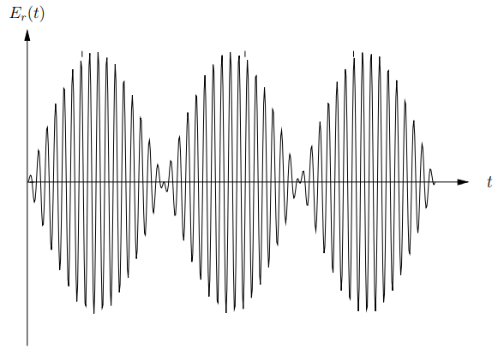



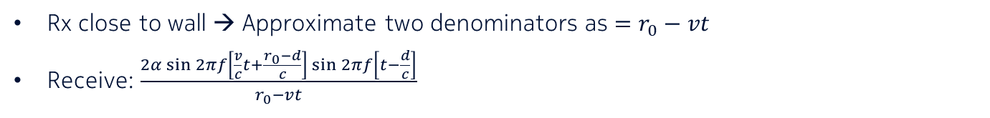



Reflecting wall, moving rx antenna → Fading
Freq. $f\left(1−\frac{v}{c}\right)$
Freq. $f\left(1+\frac{v}{c}\right)$
→ Doppler spread $=\frac{2fv}{c}≈50$Hz
Transmit electrical field: $α\cos{2πft}$
Receive: $\frac{α\cos{2πf\left(t−\frac{r_{0}+vt}{c}\right)}}{r_{0}+vt}−\frac{α\cos{2πf\left(t−\frac{2d−r_{0}−vt}{c}\right)}}{2d−r_{0}−vt}$
$$r_{0}+vt$$
$$d$$
Rx close to wall → Approximate two denominators as $=r_{0}−vt$
Receive: $\frac{2α\sin{2πf}\left[\frac{v}{c}t+\frac{r_{0}−d}{c}\right]\sin{2πf\left[t−\frac{d}{c}\right]}}{r_{0}−vt}$
Slow – Doppler_spread/2: Fading
Fast – original frequency $f$

Slide 9
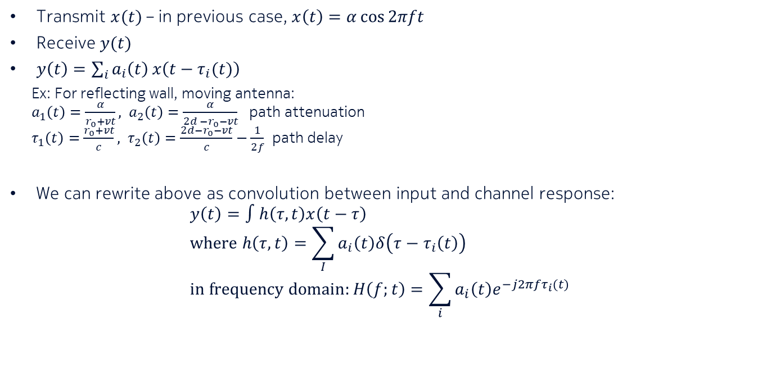
Wireless channel as linear time invariant system
Transmit $x(t)$ – in previous case, $x\left(t\right)=α\cos{2πft}$
Receive $y(t)$
$y\left(t\right)=\sum_{i}{a_{i}\left(t\right)}x\left(t−τ_{i}(t)\right)$
  Ex: For reflecting wall, moving antenna:
  $a_{1}\left(t\right)=\frac{α}{r_{0}+vt}, a_{2}\left(t\right)=\frac{α}{2d −r_{0}−vt}$ path attenuation
  $τ_{1}\left(t\right)=\frac{r_{0}+vt}{c}, τ_{2}\left(t\right)=\frac{2d−r_{0}−vt}{c}−\frac{1}{2f}$ path delay
We can rewrite above as convolution between input and channel response:
$y\left(t\right)=∫h\left(τ,t\right)x\left(t−τ\right)$
$where h\left(τ,t\right)=\sum_{I}{a_{i}\left(t\right)δ\left(τ−τ_{i}\left(t\right)\right)}$
$in frequency domain:H\left(f;t\right)=\sum_{i}{a_{i}\left(t\right)e^{−j2πfτ_{i}(t)}}$

Slide 10
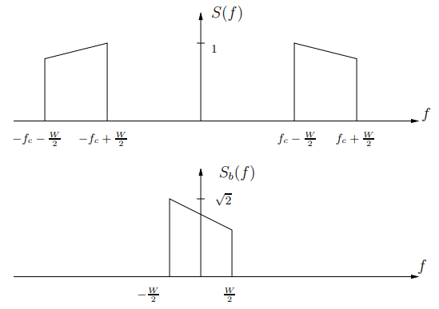

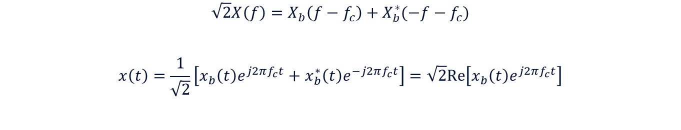

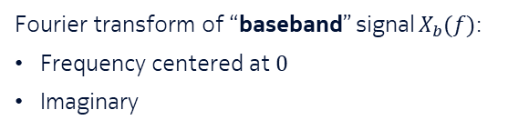
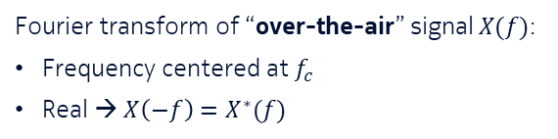
Baseband equivalent model
$$X(f)$$
Fourier transform of “over-the-air” signal $X(f)$:
Frequency centered at $f_{c}$
Real → $X\left(−f\right)=X^{∗}(f)$
Move a step closer to reality: Transmit something different from a pure sinusoid
$$X_{b}(f)$$
Fourier transform of “baseband” signal $X_{b}(f)$:
Frequency centered at $0$
Imaginary
$$\sqrt{2}X\left(f\right)=X_{b}\left(f−f_{c}\right)+X_{b}^{∗}(−f−f_{c})$$
$$x\left(t\right)=\frac{1}{\sqrt{2}}\left[x_{b}\left(t\right)e^{j2πf_{c}t}+x_{b}^{∗}\left(t\right)e^{−j2πf_{c}t}\right]=\sqrt{2}Re\left[x_{b}\left(t\right)e^{j2πf_{c}t}\right]$$
inverse Fourier transform

Slide 11
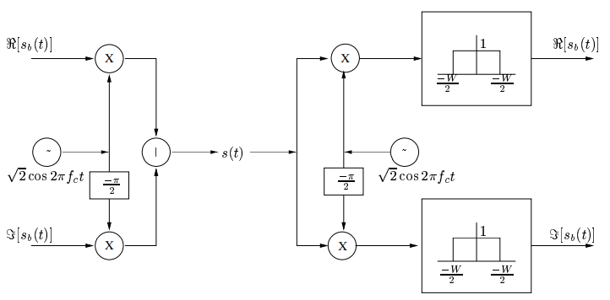





Baseband equivalent model
$$x\left(t\right)=\sqrt{2}ℛ\left[x_{b}\left(t\right)e^{j2πf_{c}t}\right]=Re\left[x_{b}\left(t\right)\right]\sqrt{2}\cos{2πf_{c}t}−Im\left[x_{b}\left(t\right)\right]\sqrt{2}\sin{2πf_{c}t}$$
Transmitter
Receiver
$$Re\left[x_{b}\left(t\right)\right]$$
$$Re\left[x_{b}\left(t\right)\right]$$
$$Im\left[x_{b}\left(t\right)\right]$$
$$Im\left[x_{b}\left(t\right)\right]$$
Low-pass filter

Slide 12



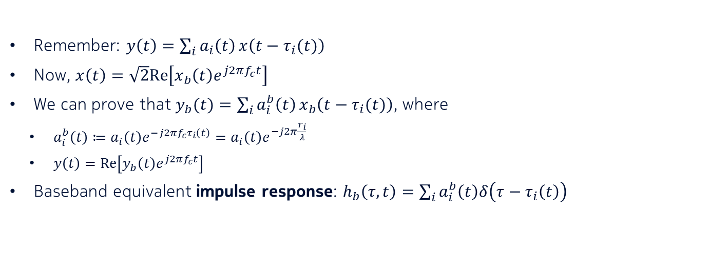





Baseband equivalent model
Remember: $y\left(t\right)=\sum_{i}{a_{i}\left(t\right)}x\left(t−τ_{i}(t)\right)$
Now, $x\left(t\right)=\sqrt{2}Re\left[x_{b}\left(t\right)e^{j2πf_{c}t}\right]$
We can prove that $y_{b}(t)=\sum_{i}{a_{i}^{b}\left(t\right)}x_{b}\left(t−τ_{i}(t)\right)$, where
  $a_{i}^{b}\left(t\right)≔a_{i}\left(t\right)e^{−j2πf_{c}τ_{i}\left(t\right)}=a_{i}\left(t\right)e^{−j2π\frac{r_{i}}{λ}}$
  $y\left(t\right)=Re\left[y_{b}\left(t\right)e^{j2πf_{c}t}\right]$
Baseband equivalent impulse response: $h_{b}\left(τ,t\right)=\sum_{i}{a_{i}^{b}\left(t\right)δ\left(τ−τ_{i}\left(t\right)\right)}$
Phase shift due to distance
Path loss
$$Re\left[h_{b}\left(τ,t\right)\right]$$
$$τ_{1}(t)$$
$$τ_{2}(t)$$
$$τ_{3}(t)$$
$$Im\left[h_{b}\left(τ,t\right)\right]$$
$$τ_{1}(t)$$
$$τ_{2}(t)$$
$$τ_{3}(t)$$

Slide 13
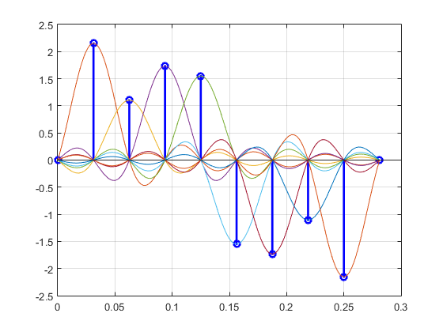
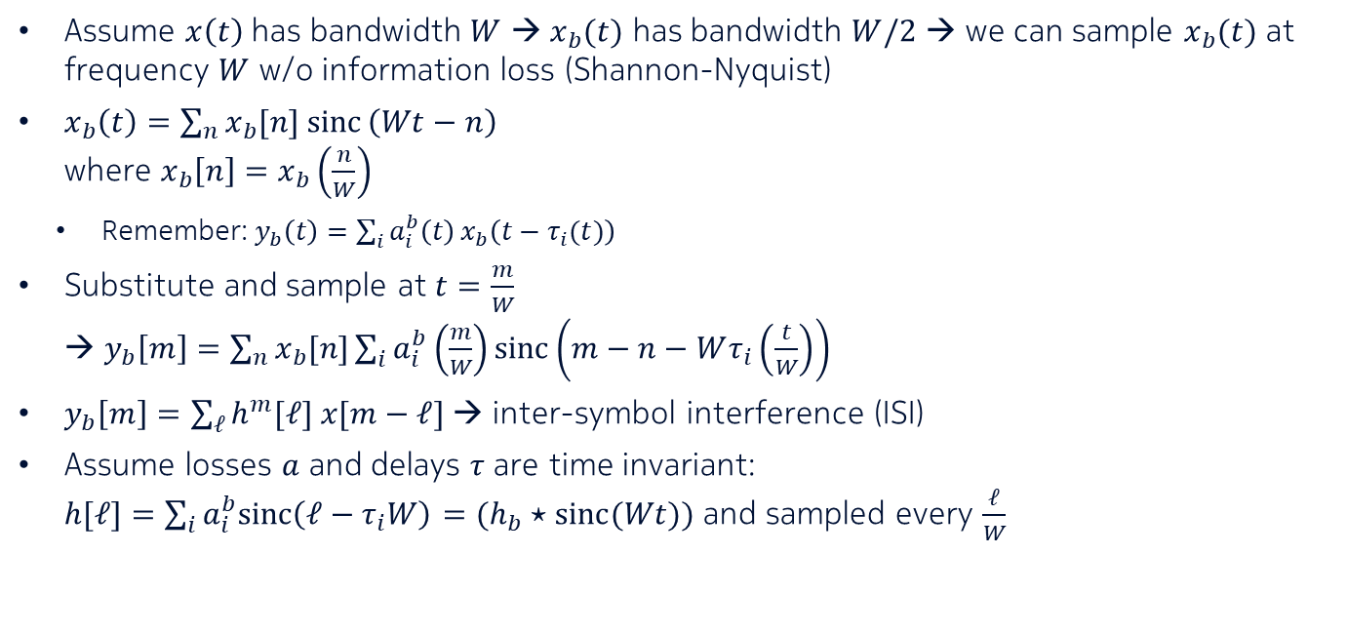

Discrete-time baseband model
Assume $x\left(t\right)$ has bandwidth $W$ → $x_{b}(t)$ has bandwidth $W/2$ → we can sample $x_{b}(t)$ at frequency $W$ w/o information loss (Shannon-Nyquist)
$x_{b}\left(t\right)=\sum_{n}{x_{b}[n] sinc}\left(Wt−n\right)$
where $x_{b}\left[n\right]=x_{b}\left(\frac{n}{W}\right)$
  Remember: $y_{b}\left(t\right)=\sum_{i}{a_{i}^{b}\left(t\right)}x_{b}\left(t−τ_{i}(t)\right)$
Substitute and sample at $t=\frac{m}{W}$
→ $y_{b}\left[m\right]=\sum_{n}{x_{b}[n]}\sum_{i}{a_{i}^{b}\left(\frac{m}{W}\right)sinc\left(m−n−Wτ_{i}\left(\frac{t}{W}\right)\right)}$
$y_{b}\left[m\right]=\sum_{ℓ}{h^{m}[ℓ] x[m−ℓ]}$ → inter-symbol interference (ISI)
Assume losses $a$ and delays $τ$ are time invariant:
$h[ℓ]=\sum_{i}{a_{i}^{b}sinc\left(ℓ−τ_{i}W\right)}=(h_{b}⋆sinc(Wt))$ and sampled every $\frac{ℓ}{W}$
$$1/W$$

Slide 14
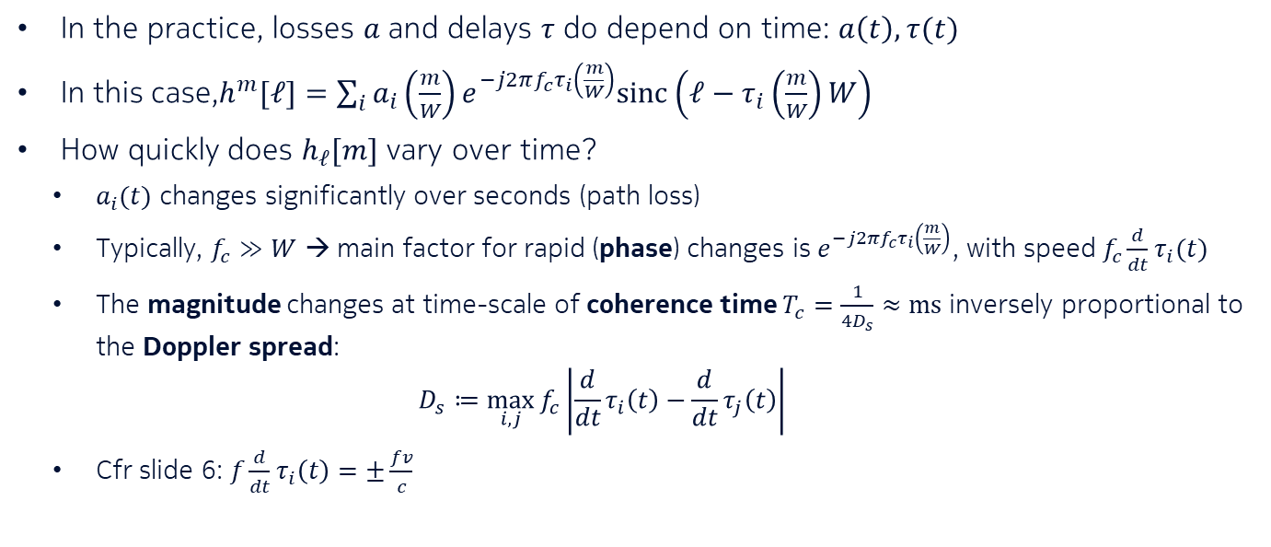
Fading: Time-varying channel (cfr slide 6)
In the practice, losses $a$ and delays $τ$ do depend on time: $a\left(t\right),τ(t)$
In this case,$h^{m}[ℓ]=\sum_{i}{a_{i}\left(\frac{m}{W}\right)e^{−j2πf_{c}τ_{i}\left(\frac{m}{W}\right)}sinc\left(ℓ−τ_{i}\left(\frac{m}{W}\right)W\right)}$
How quickly does $h_{ℓ}[m]$ vary over time?
  $a_{i}(t)$ changes significantly over seconds (path loss)
  Typically, $f_{c}≫W$ → main factor for rapid (phase) changes is $e^{−j2πf_{c}τ_{i}\left(\frac{m}{W}\right)}$, with speed $f_{c}\frac{d}{dt}τ_{i}(t)$
  The magnitude changes at time-scale of coherence time $T_{c}=\frac{1}{{4D}_{s}}≈ms$ inversely proportional to the Doppler spread:
  $D_{s}≔\max_{i,j}{f_{c}\left|\frac{d}{dt}τ_{i}\left(t\right)−\frac{d}{dt}τ_{j}\left(t\right)\right|}$
  Cfr slide 6: $f\frac{d}{dt}τ_{i}\left(t\right)=±\frac{fv}{c}$

Slide 15

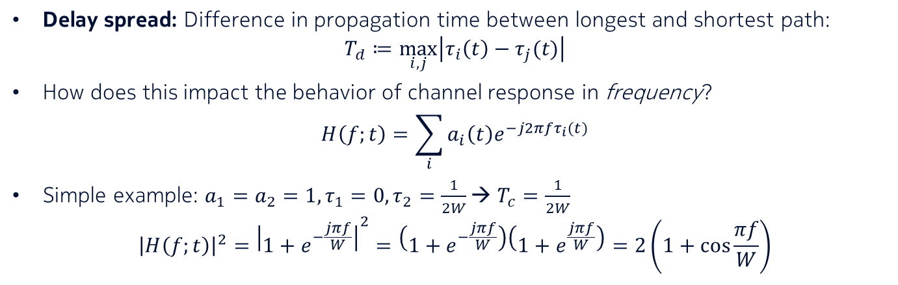
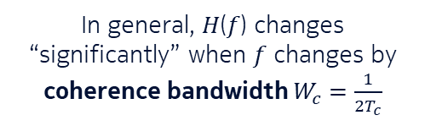

Delay spread: Frequency-varying channel (cfr slide 5)
Delay spread: Difference in propagation time between longest and shortest path:
$T_{d}≔\max_{i,j}\left|τ_{i}\left(t\right)−τ_{j}(t)\right|$
How does this impact the behavior of channel response in frequency?
$H\left(f;t\right)=\sum_{i}{a_{i}\left(t\right)e^{−j2πfτ_{i}(t)}}$
Simple example: $a_{1}=a_{2}=1, τ_{1}=0,τ_{2}=\frac{1}{2W}$→ $T_{c}=\frac{1}{2W}$
${\left|H\left(f;t\right)\right|}^{2}={\left|1+e^{−\frac{jπf}{W}}\right|}^{2}=\left(1+e^{−\frac{jπf}{W}}\right)\left(1+e^{\frac{jπf}{W}}\right)=2\left(1+\cos{\frac{πf}{W}}\right)$
$${\left|H\left(f;t\right)\right|}^{2}$$
In general, 𝐻(𝑓) changes “significantly” when $f$ changes by coherence bandwidth $W_{c}=\frac{1}{2T_{c}}$
$$W=\frac{1}{2T_{c}}$$

Slide 16
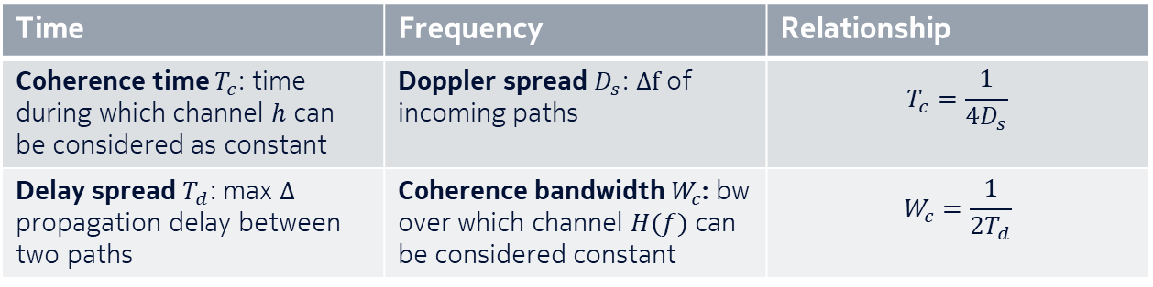
The 4 main actors
Time | Frequency | Relationship
Coherence time $T_{c}$: time during which channel $h$ can be considered as constant | Doppler spread $D_{s}$: $Δf$ of incoming paths | $$T_{c}=\frac{1}{{4D}_{s}}$$
Delay spread $T_{d}$: max $Δ$ propagation delay between two paths | Coherence bandwidth $W_{c}$: bw over which channel $H(f)$ can be considered constant | $$W_{c}=\frac{1}{2T_{d}}$$

Slide 17
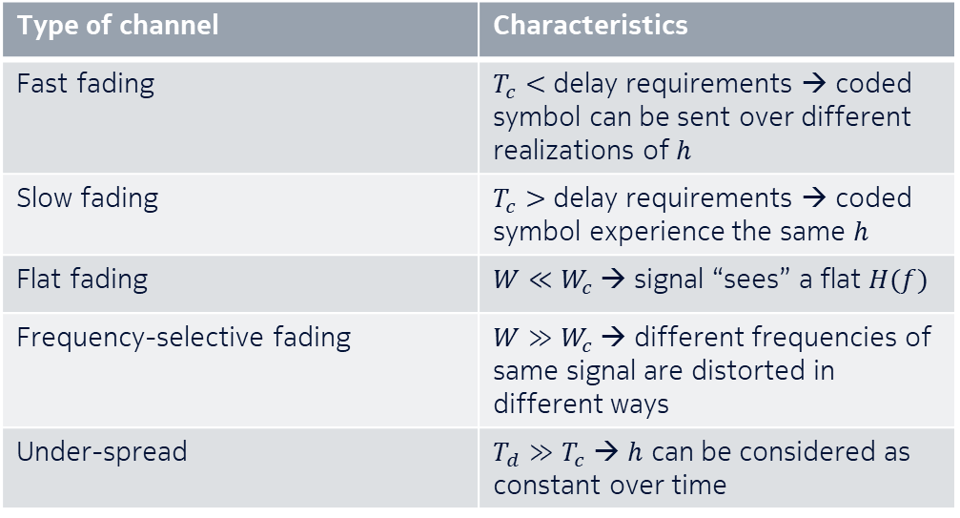
Terminology
Type of channel | Characteristics
Fast fading | $T_{c}<$ delay requirements → coded symbol can be sent over different realizations of $h$
Slow fading | $T_{c}>$ delay requirements → coded symbol experience the same $h$
Flat fading | $W≪W_{c}$ → signal “sees” a flat $H(f)$
Frequency-selective fading | $W≫W_{c}$ → different frequencies of same signal are distorted in different ways
Under-spread | $T_{d}≫T_{c}$ → $h$ can be considered as constant over time

Slide 18
Part 2: Eliminating ISI via OFDM
March 22, 2023

Slide 19


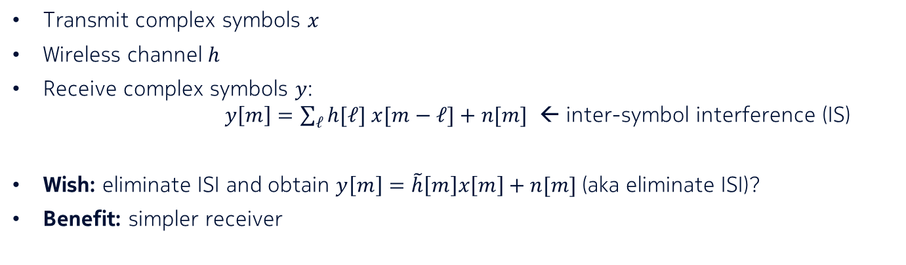



Inter-symbol interference (ISI)
Tx
noise $n$
Rx
channel
$$x$$
$$⋆$$
$$h$$
$$y$$
Transmit complex symbols $x$
Wireless channel $h$
Receive complex symbols $y$:
$y\left[m\right]=\sum_{ℓ}{h[ℓ] x[m−ℓ]}+n[m]$ ← inter-symbol interference (IS)
Wish: eliminate ISI and obtain $y\left[m\right]=\tilde{h}\left[m\right]x\left[m\right]+n[m]$ (aka eliminate ISI)?
Benefit: simpler receiver

Slide 20










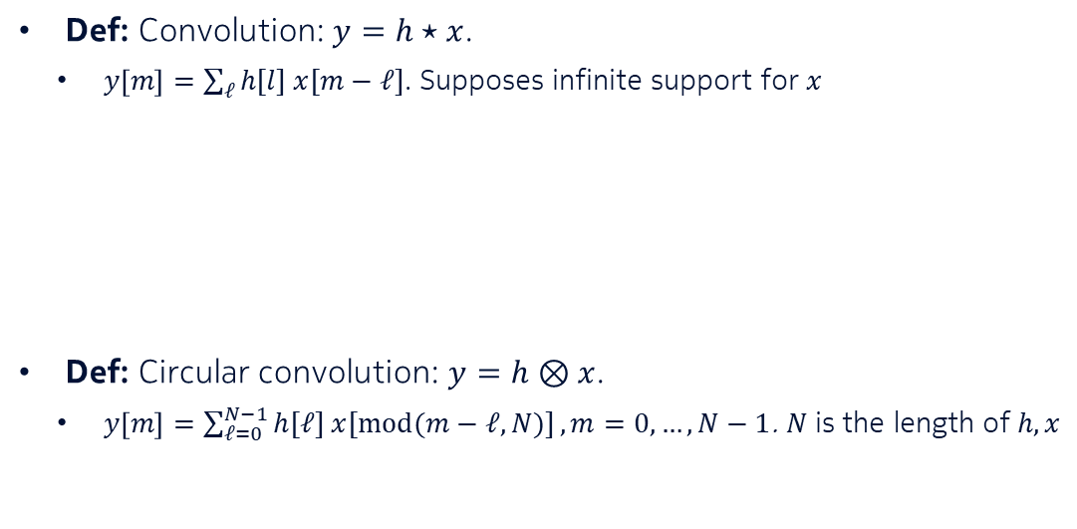




















Main ingredients
Def: Convolution: $y=h⋆x$.
  $y\left[m\right]=\sum_{ℓ}{h[l] x[m−ℓ]}$. Supposes infinite support for $x$
Def: Circular convolution: $y=h⊗x$.
  $y\left[m\right]=\sum_{ℓ=0}^{N−1}{h[ℓ] x[mod(m−ℓ,N)]}, m=0,…,N−1$. $N$ is the length of $h,x$
$$…$$
$$x[−3]$$
$$x[−2]$$
$$x[−1]$$
$$x[0]$$
$$x[1]$$
$$x[2]$$
$$…$$
$$∑$$
$$×$$
$$×$$
$$×$$
$$×$$
$$=y[0]$$
$$h[3]$$
$$h[2]$$
$$h[1]$$
$$h[0]$$
$$x[0]$$
$$x[1]$$
$$x[2]$$
$$x[3]$$
$$∑$$
$$×$$
$$×$$
$$×$$
$$×$$
$$=y[0]$$
$$h[0]$$
$$h[3]$$
$$h[2]$$
$$h[1]$$

Slide 21
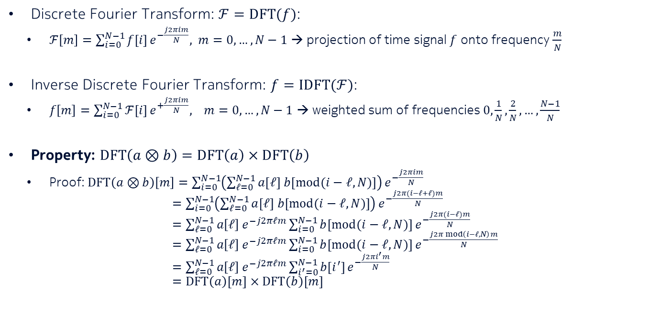
Main ingredients (cont’d)
Discrete Fourier Transform: $ℱ=DFT(f)$:
  $ℱ\left[m\right]=\sum_{i=0}^{N−1}{f[i]}e^{−\frac{j2πim}{N}}, m=0,…,N−1$ → projection of time signal $f$ onto frequency $\frac{m}{N}$
Inverse Discrete Fourier Transform: $f=IDFT(ℱ)$:
  $f\left[m\right]=\sum_{i=0}^{N−1}{ℱ[i]}e^{+\frac{j2πim}{N}}, m=0,…,N−1$ → weighted sum of frequencies $0,\frac{1}{N},\frac{2}{N},…,\frac{N−1}{N}$
Property: $DFT\left(a⊗b\right)=DFT\left(a\right)×DFT\left(b\right)$
  Proof: $DFT\left(a⊗b\right)\left[m\right]=\sum_{i=0}^{N−1}{\left(\sum_{ℓ=0}^{N−1}{a[ℓ] b[mod(i−ℓ,N)]}\right)}e^{−\frac{j2πim}{N}}$
  $=\sum_{i=0}^{N−1}{\left(\sum_{ℓ=0}^{N−1}{a[ℓ] b[mod(i−ℓ,N)]}\right)}e^{−\frac{j2π(i−ℓ+ℓ)m}{N}}$
  $=\sum_{ℓ=0}^{N−1}{a\left[ℓ\right]}e^{−j2πℓm}\sum_{i=0}^{N−1}{b[mod(i−ℓ,N)]}e^{−\frac{j2π(i−ℓ)m}{N}}$
  $=\sum_{ℓ=0}^{N−1}{a\left[ℓ\right]}e^{−j2πℓm}\sum_{i=0}^{N−1}{b[mod(i−ℓ,N)]}e^{−\frac{j2π mod\left(i−ℓ,N\right)m}{N}}$
  $=\sum_{ℓ=0}^{N−1}{a\left[ℓ\right]}e^{−j2πℓm}\sum_{i^{′}=0}^{N−1}{b[i^{′}]}e^{−\frac{j2πi^{′}m}{N}}$
  $=DFT\left(a\right)[m]×DFT\left(b\right)[m]$

Slide 22



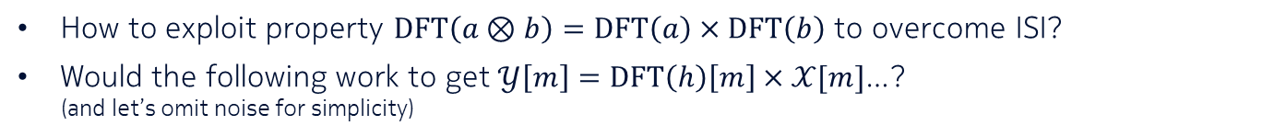






Towards Orthogonal Frequency Division Multiplexing (OFDM)
How to exploit property $DFT\left(a⊗b\right)=DFT\left(a\right)×DFT\left(b\right)$ to overcome ISI?
Would the following work to get $𝒴\left[m\right]=DFT\left(h\right)\left[m\right]×𝒳[m]$…?
(and let’s omit noise for simplicity)
Symbols
to transmit
What is effectively
transmitted
Decoded
symbols
$$𝒳\left[0\right]$$
$$y\left[0\right]$$
S/P
IDFT
channel
S/P
DFT
$$𝒳\left[0\right],…,𝒳[N−1]$$
$$x\left[0\right],…,x[N−1]$$
$$y=h⋆x$$
$$𝒴\left[0\right],…,𝒴[N−1]$$
$$h$$
$$𝒳[N−1]$$
$$y[N−1]$$
…almost! It would if convolution were circular

Slide 23
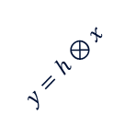



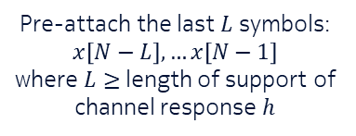
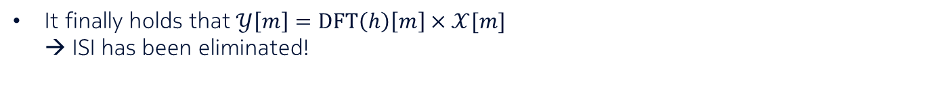







OFDM
Symbols
to transmit
What is effectively
transmitted
Decoded
symbols
$$𝒳\left[0\right]$$
$$y\left[0\right]$$
S/P
IDFT
channel
S/P
DFT
$$𝒳\left[0\right],…,𝒳[N−1]$$
$$x\left[0\right],…,x[N−1]$$
$$⋆$$
$$y=h⊗x$$
$$𝒴\left[0\right],…,𝒴[N−1]$$
$$h$$
$$𝒳[N−1]$$
$$y[N−1]$$
Pre-attach the last $L$ symbols:
$$x\left[N−L\right],…x\left[N−1\right]$$
where $L≥$ length of support of channel response $h$
The rx “sees” here a circular convolution!
Remove the first $L$ rx symbols
It finally holds that $𝒴\left[m\right]=DFT\left(h\right)\left[m\right]×𝒳[m]$
→ ISI has been eliminated!

Slide 24
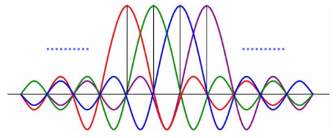
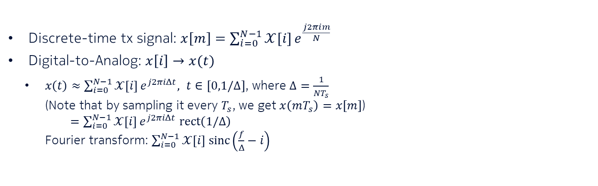
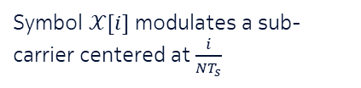

OFDM: A continuous time/frequency view
Tx signal spectrum
Discrete-time tx signal: $x\left[m\right]=\sum_{i=0}^{N−1}{𝒳[i]}e^{\frac{j2πim}{N}}$
Digital-to-Analog: $x\left[i\right]→x(t)$
  $x\left(t\right)≈\sum_{i=0}^{N−1}{𝒳\left[i\right]}e^{j2πiΔt}, t∈[0,1/Δ]$, where $Δ=\frac{1}{NT_{s}}$
  (Note that by sampling it every $T_{s}$, we get $x\left(mT_{s}\right)=x[m]$)
  $=\sum_{i=0}^{N−1}{𝒳\left[i\right]}e^{j2πiΔt} rect\left(1/Δ\right)$
  Fourier transform: $\sum_{i=0}^{N−1}{𝒳\left[i\right] sinc\left(\frac{f}{Δ}−i\right)}$
$$Δ$$
Symbol $𝒳[i]$ modulates a sub-carrier centered at $\frac{i}{NT_{s}}$

Slide 25
Part 3: Receiver diversity
March 22, 2023

Slide 26
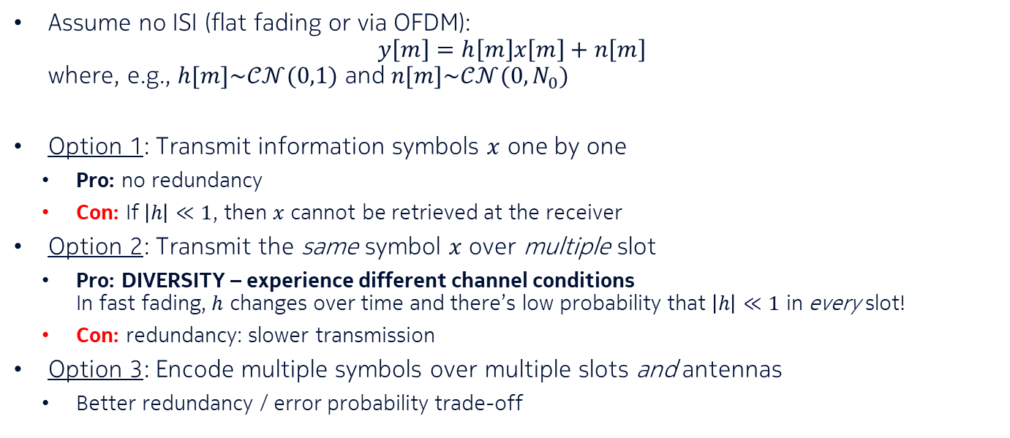
Main picture
How to transmit information efficiently?
Assume no ISI (flat fading or via OFDM):
$y\left[m\right]=h\left[m\right]x\left[m\right]+n\left[m\right]$
where, e.g., $h[m]\sim 𝒞𝒩(0,1)$ and $n[m]\sim 𝒞𝒩(0,N_{0})$
Option 1: Transmit information symbols $x$ one by one
  Pro: no redundancy
  Con: If $\left|h\right|≪1$, then $x$ cannot be retrieved at the receiver
Option 2: Transmit the same symbol $x$ over multiple slot
  Pro: DIVERSITY – experience different channel conditions
  In fast fading, $h$ changes over time and there’s low probability that $\left|h\right|≪1$ in every slot!
  Con: redundancy: slower transmission
Option 3: Encode multiple symbols over multiple slots and antennas
  Better redundancy / error probability trade-off

Slide 27
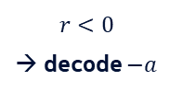


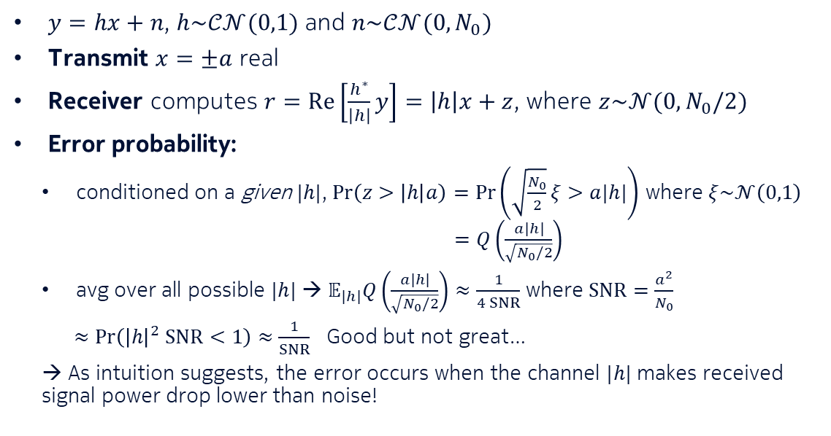

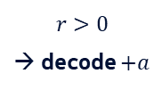

Tx rate: 1 symbol / slot
Transmit symbols one by one
$y=hx+n$, $h\sim 𝒞𝒩(0,1)$ and $n\sim 𝒞𝒩(0,N_{0})$
Transmit $x=±a$ real
Receiver computes $r=Re\left[\frac{h^{∗}}{\left|h\right|}y\right]=\left|h\right|x+z$, where $z\sim 𝒩(0,N_{0}/2)$
Error probability:
  conditioned on a given $|h|$, $\operatorname{Pr}\left(z>\left|h\right|a\right)=\operatorname{Pr}\left(\sqrt{\frac{N_{0}}{2}}ξ>a|h|\right)$ where $ξ\sim 𝒩\left(0,1\right)$
  $=Q\left(\frac{a|h|}{\sqrt{N_{0}/2}}\right)$
  avg over all possible $|h|$ → $𝔼_{|h|}Q\left(\frac{a|h|}{\sqrt{N_{0}/2}}\right)≈\frac{1}{4 SNR}$ where $SNR=\frac{a^{2}}{N_{0}}$
  $≈\operatorname{Pr}\left({\left|h\right|}^{2} SNR<1\right)≈\frac{1}{SNR}$ Good but not great…
  → As intuition suggests, the error occurs when the channel $|h|$ makes received signal power drop lower than noise!
$$y$$
$$r>0$$
→ decode $+a$
$$h$$
$$y$$
$$r<0$$
→ decode $−a$
$$h$$

Slide 28
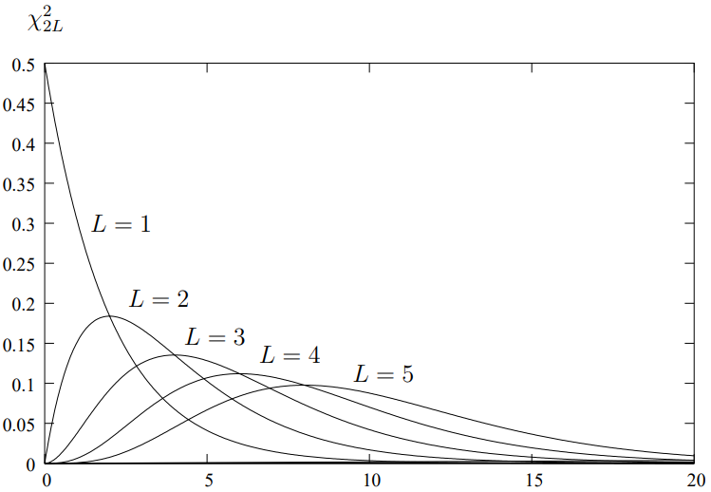
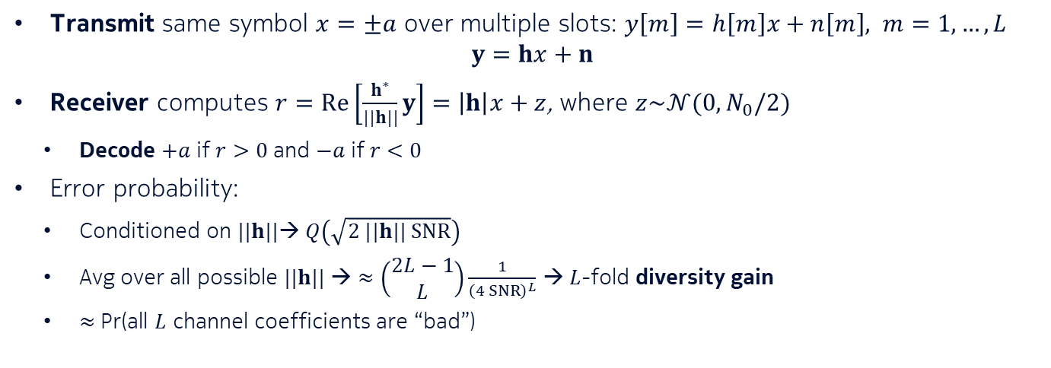

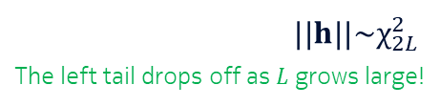
Tx rate: $\frac{1}{L}$ symbols / slot
Repetition code
Transmit same symbol $x=±a$ over multiple slots: $y\left[m\right]=h\left[m\right]x+n\left[m\right], m=1,…,L$
$y=hx+n$
Receiver computes $r=Re\left[\frac{h^{∗}}{||h||}y\right]=\left|h\right|x+z$, where $z\sim 𝒩(0,N_{0}/2)$
  Decode $+a$ if $r>0$ and $−a$ if $r<0$
Error probability:
  Conditioned on $||h||$→ $Q\left(\sqrt{2 ||h|| SNR}\right)$
  Avg over all possible $||h||$ → $≈\left(\begin{aligned}2L−1 \\ L\end{aligned}\right)\frac{1}{{\left(4 SNR\right)}^{L}}$ → $L$-fold diversity gain
  $≈$ Pr(all $L$ channel coefficients are “bad”)
$||h||\sim χ_{2L}^{2}$
The left tail drops off as $L$ grows large!

Slide 29


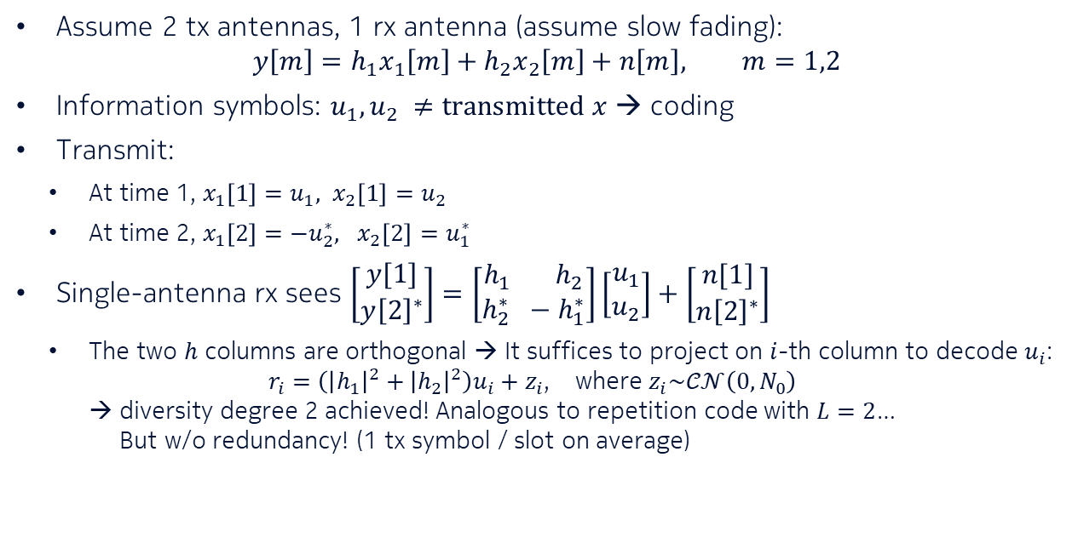



Tx rate: 1 symbol / slot
Alamouti scheme
Assume 2 tx antennas, 1 rx antenna (assume slow fading):
$y\left[m\right]=h_{1}x_{1}\left[m\right]+h_{2}x_{2}\left[m\right]+n\left[m\right], m=1,2$
Information symbols: $u_{1},u_{2} ≠transmitted x$ → coding
Transmit:
  At time 1, $x_{1}\left[1\right]=u_{1}, x_{2}\left[1\right]=u_{2}$
  At time 2, $x_{1}\left[2\right]=−u_{2}^{∗}, x_{2}\left[2\right]=u_{1}^{∗}$
Single-antenna rx sees $\left[\begin{aligned}y[1] \\ y{\left[2\right]}^{∗}\end{aligned}\right]=\left[\begin{aligned}h_{1} h_{2} \\ h_{2}^{∗} −h_{1}^{∗}\end{aligned}\right]\left[\begin{aligned}u_{1} \\ u_{2}\end{aligned}\right]+\left[\begin{aligned}n[1] \\ n{\left[2\right]}^{∗}\end{aligned}\right]$
  The two $h$ columns are orthogonal → It suffices to project on $i$-th column to decode $u_{i}$:
  $r_{i}=\left({\left|h_{1}\right|}^{2}+{\left|h_{2}\right|}^{2}\right)u_{i}+z_{i}$, where $z_{i}\sim 𝒞𝒩\left(0,N_{0}\right)$
  → diversity degree 2 achieved! Analogous to repetition code with $L=2$…
  But w/o redundancy! (1 tx symbol / slot on average)
$$x_{1}$$
$$h_{1}$$
$$y$$
$$x_{2}$$
$$h_{2}$$

Slide 30
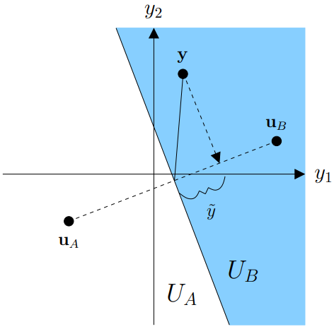



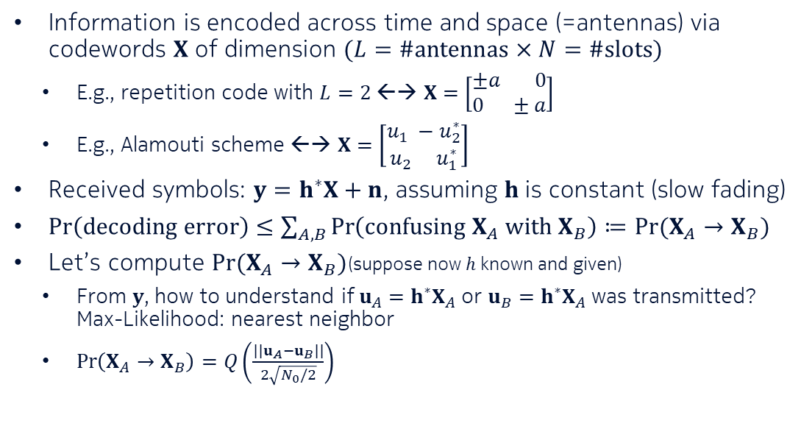



Space-time codes
A generalization of Alamouti and repetition codes
Information is encoded across time and space (=antennas) via codewords $X$ of dimension $(L=\#antennas×N=\#slots)$
  E.g., repetition code with $L=2$ ←→ $X=\left[\begin{aligned}±a 0 \\ 0 ±a\end{aligned}\right]$
  E.g., Alamouti scheme ←→ $X=\left[\begin{aligned}u_{1} −u_{2}^{∗} \\ u_{2} u_{1}^{∗}\end{aligned}\right]$
Received symbols: $y=h^{∗}X+n$, assuming $h$ is constant (slow fading)
$\operatorname{Pr}\left(decoding error\right)≤\sum_{A,B}{\operatorname{Pr}\left(confusing X_{A} with X_{B}\right)}≔Pr⁡(X_{A}→X_{B})$
Let’s compute $Pr⁡(X_{A}→X_{B})$(suppose now $h$ known and given)
  From $y$, how to understand if $u_{A}=h^{∗}X_{A}$or $u_{B}=h^{∗}X_{A}$ was transmitted?
  Max-Likelihood: nearest neighbor
  $\operatorname{Pr}\left(X_{A}→X_{B}\right)=Q\left(\frac{||u_{A}−u_{B}||}{2\sqrt{N_{0}/2}}\right)$
$$h_{1}$$
antennas
$$y$$
$$X_{:,n}$$
$$…$$
slots
$$…$$
$$h_{L}$$
$$h$$

Slide 31

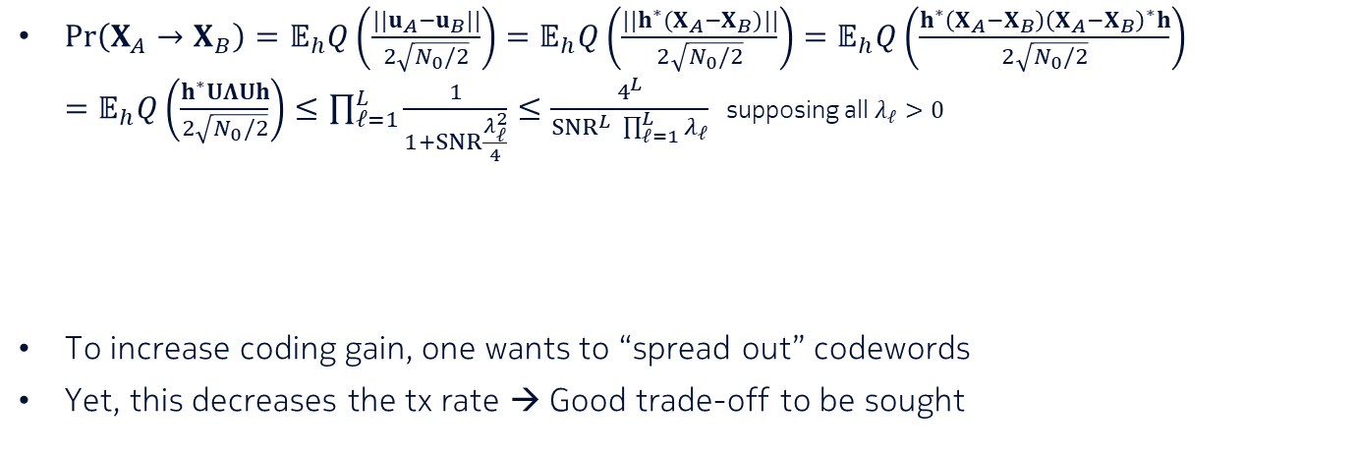
Space-time codes (cont’d)
Hermitian ($.=.^{∗}$)
→ diagonalizable as $UΛU$ where $UU^{∗}=I$ and $Λ=diag(λ_{1},…,λ_{L})$
$\operatorname{Pr}\left(X_{A}→X_{B}\right)=𝔼_{h}Q\left(\frac{||u_{A}−u_{B}||}{2\sqrt{N_{0}/2}}\right)=𝔼_{h}Q\left(\frac{||h^{∗}(X_{A}−X_{B})||}{2\sqrt{N_{0}/2}}\right)=𝔼_{h}Q\left(\frac{h^{∗}\left(X_{A}−X_{B}\right){\left(X_{A}−X_{B}\right)}^{∗}h}{2\sqrt{N_{0}/2}}\right)$
$=𝔼_{h}Q\left(\frac{h^{∗}UΛUh}{2\sqrt{N_{0}/2}}\right)≤\prod_{ℓ=1}^{L}{\frac{1}{1+SNR\frac{λ_{ℓ}^{2}}{4}}}≤\frac{4^{L}}{{SNR}^{L} \prod_{ℓ=1}^{L}{λ_{ℓ}}}$ supposing all $λ_{ℓ}>0$
To increase coding gain, one wants to “spread out” codewords
Yet, this decreases the tx rate → Good trade-off to be sought
“Coding” gain: depends on how codewords are designed
Diversity gain

