Slide 1




Around the Poisson-Voronoi tessellation
Pierre Popineau
Network theory reading group – 09/06/2021

Slide 2
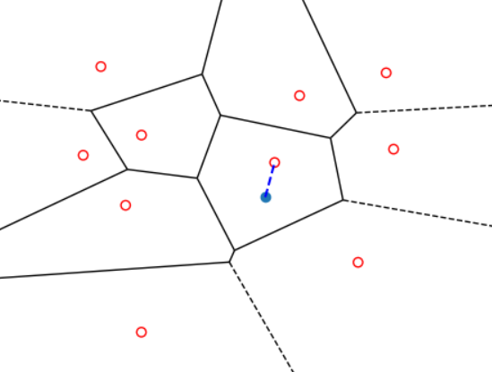
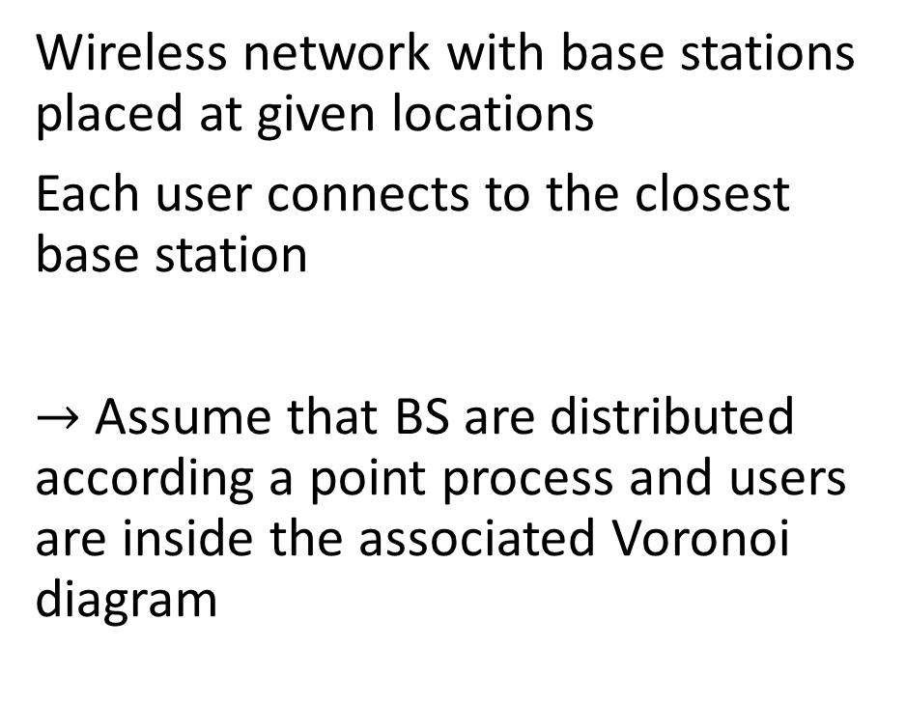
Motivation – wireless networks
Wireless network with base stations placed at given locations
Each user connects to the closest base station
$→$ Assume that BS are distributed according a point process and users are inside the associated Voronoi diagram

Slide 3
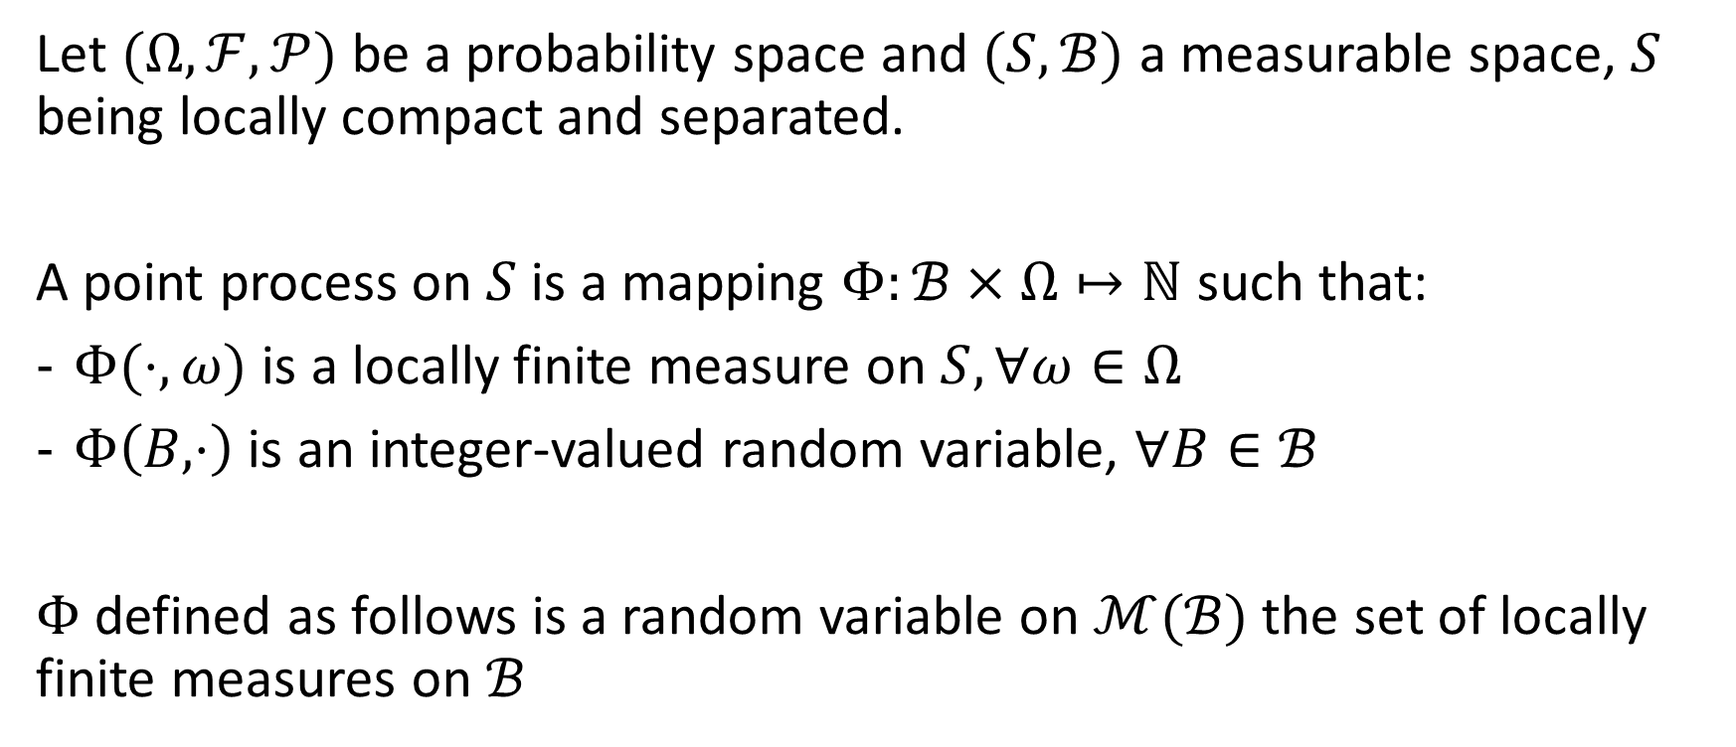
Point process
Let $(Ω, ℱ, 𝒫)$ be a probability space and $(S, ℬ)$ a measurable space, $S$ being locally compact and separated.
A point process on $S$ is a mapping $Φ:ℬ×Ω↦ℕ$ such that:
$Φ(⋅, ω)$ is a locally finite measure on $S, ∀ω∈Ω$
$Φ\left(B, ⋅\right)$ is an integer-valued random variable, $∀B∈ℬ$
$Φ$ defined as follows is a random variable on $ℳ(ℬ)$ the set of locally finite measures on $ℬ$

Slide 4
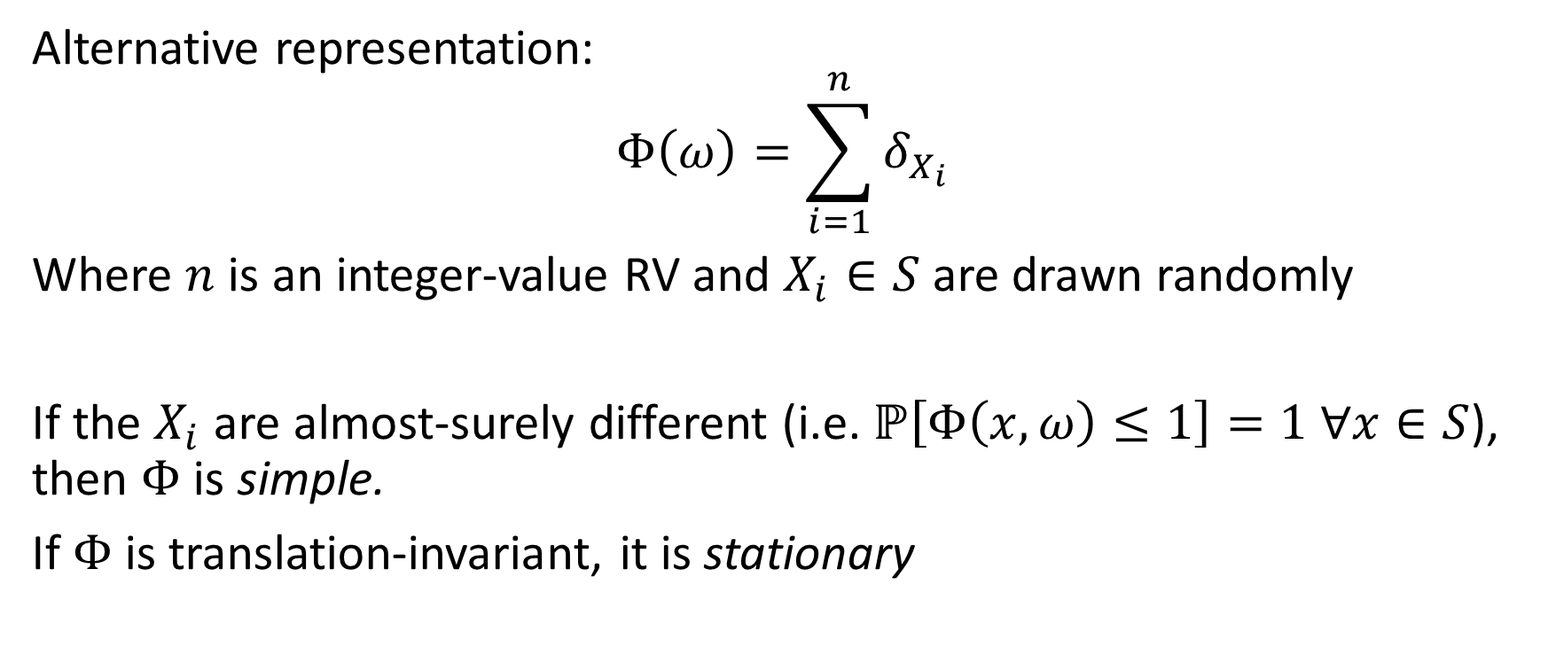
Point process
Alternative representation:
$$Φ\left(ω\right)=\sum_{i=1}^{n}{δ_{X_{i}}}$$
Where $n$ is an integer-value RV and $X_{i}∈S$ are drawn randomly
If the $X_{i}$ are almost-surely different (i.e. $ℙ\left[Φ\left(x, ω\right)≤1\right]=1 ∀x∈S$), then $Φ$ is simple.
If $Φ$ is translation-invariant, it is stationary

Slide 5
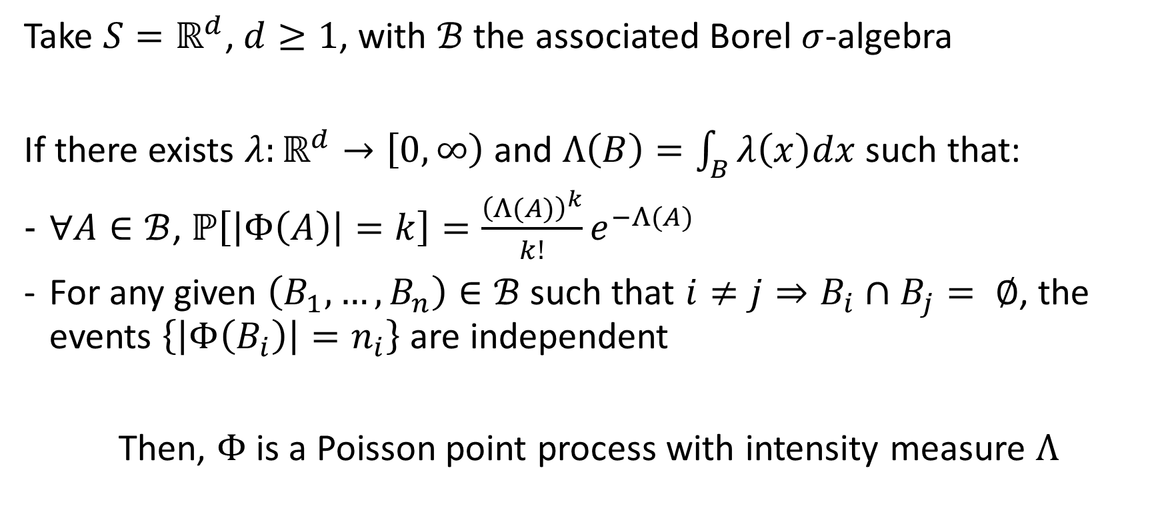
Poisson point process
Take $S=ℝ^{d}$, $d≥1$, with $ℬ$ the associated Borel $σ$-algebra
If there exists $λ:ℝ^{d}→\left[0,∞\right)$ and $Λ\left(B\right)=\int_{B}{λ\left(x\right)dx}$ such that:
$∀A∈ℬ$, $ℙ\left[\left|Φ\left(A\right)\right|=k\right]=\frac{{\left(Λ(A)\right)}^{k}}{k!}e^{−Λ(A)}$
For any given $\left(B_{1}, …, B_{n}\right)∈ℬ$ such that $i≠j⇒B_{i}∩B_{j}= ∅$, the events $\left\{\left|Φ\left(B_{i}\right)\right|=n_{i}\right\}$ are independent
Then, $Φ$ is a Poisson point process with intensity measure $Λ$

Slide 6
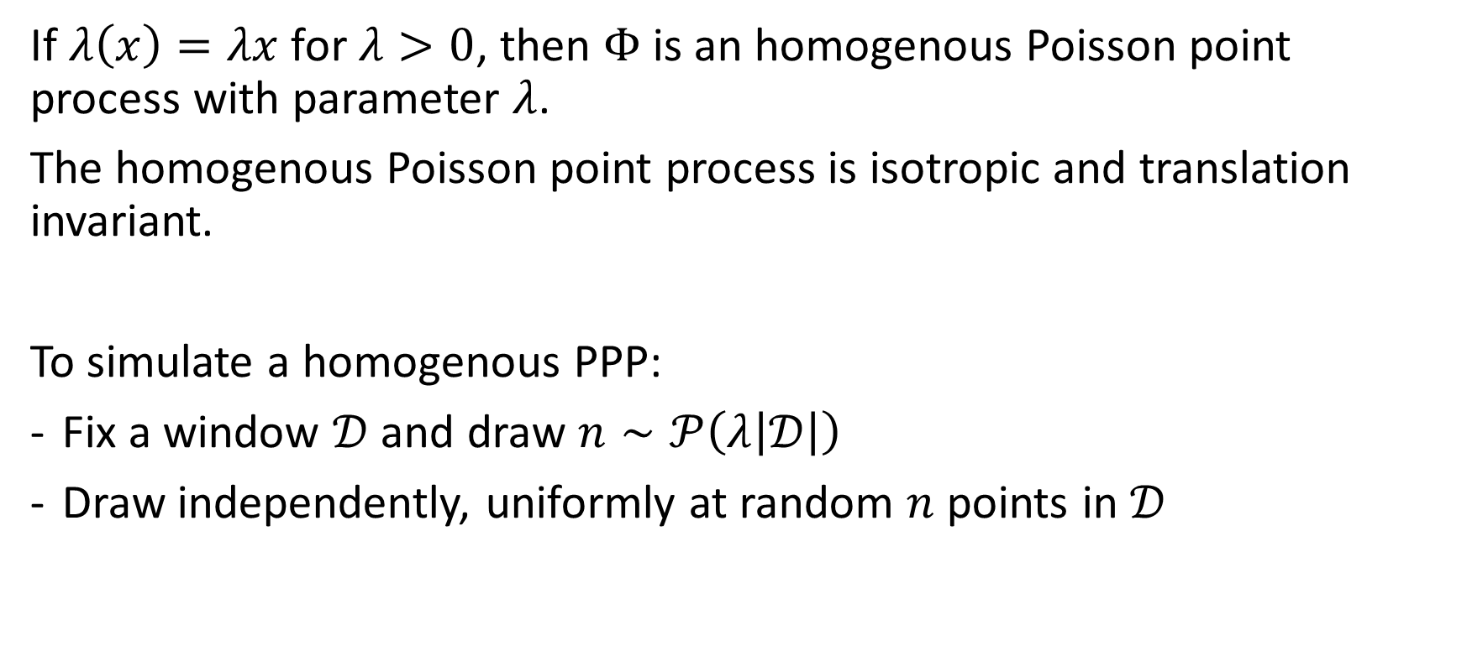
Poisson point process
If $λ\left(x\right)=λx$ for $λ>0$, then $Φ$ is an homogenous Poisson point process with parameter $λ$.
The homogenous Poisson point process is isotropic and translation invariant.
To simulate a homogenous PPP:
Fix a window $𝒟$ and draw $n∼𝒫\left(λ\left|𝒟\right|\right)$
Draw independently, uniformly at random $n$ points in $𝒟$

Slide 7
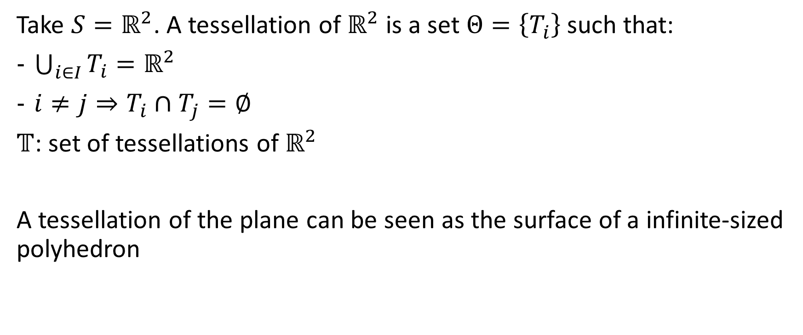
Planar random tessellation
Take $S=ℝ^{2}$. A tessellation of $ℝ^{2}$ is a set $Θ=\left\{T_{i}\right\}$ such that:
$\bigcup_{i∈I}{T_{i}}=ℝ^{2}$
$i≠j⇒T_{i}∩T_{j}=∅$
$𝕋$: set of tessellations of $ℝ^{2}$
A tessellation of the plane can be seen as the surface of a infinite-sized polyhedron

Slide 8
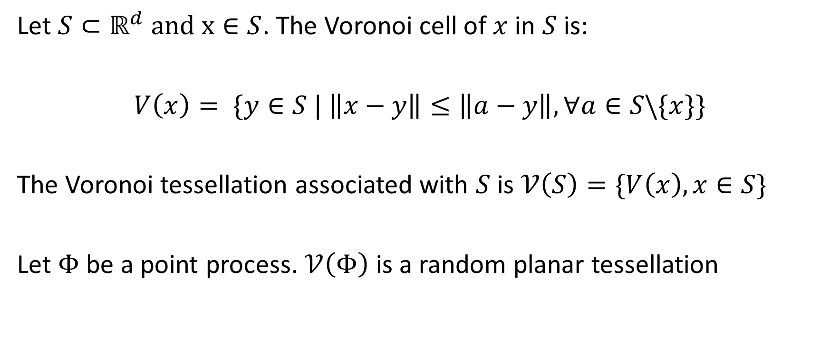
Voronoi diagram
Let $S⊂ℝ^{d} and x∈S$. The Voronoi cell of $x$ in $S$ is:
$V\left(x\right)= \{y∈S | \left\|x−y\right\|≤\left\|a−y\right\|, ∀a∈S\backslash \{x\}\}$
The Voronoi tessellation associated with $S$ is $𝒱\left(S\right)=\{V\left(x\right), x∈S\}$
Let $Φ$ be a point process. $𝒱\left(Φ\right)$ is a random planar tessellation

Slide 9
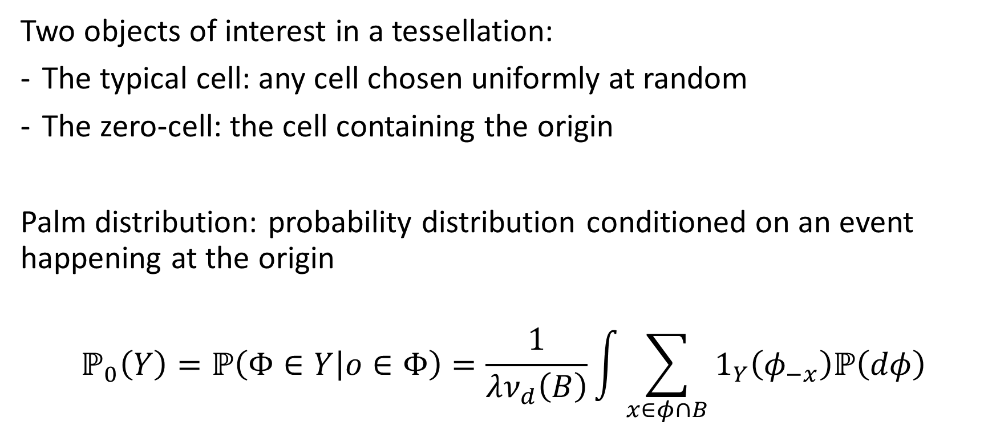
Typical cell vs zero-cell
Two objects of interest in a tessellation:
The typical cell: any cell chosen uniformly at random
The zero-cell: the cell containing the origin
Palm distribution: probability distribution conditioned on an event happening at the origin
$$ℙ_{0}\left(Y\right)=ℙ\left(Φ∈Y | o∈Φ\right)=\frac{1}{λν_{d}\left(B\right)}\int{\sum_{x∈φ∩B}{1_{Y}\left(φ_{−x}\right)ℙ\left(dφ\right)}}$$

Slide 10
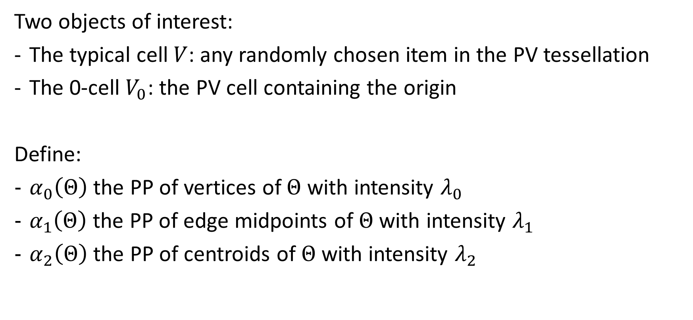
Typical cell vs 0-cell
Two objects of interest:
The typical cell $V$: any randomly chosen item in the PV tessellation
The 0-cell $V_{0}$: the PV cell containing the origin
Define:
$α_{0}\left(Θ\right)$ the PP of vertices of $Θ$ with intensity $λ_{0}$
$α_{1}\left(Θ\right)$ the PP of edge midpoints of $Θ$ with intensity $λ_{1}$
$α_{2}\left(Θ\right)$ the PP of centroids of $Θ$ with intensity $λ_{2}$

Slide 11
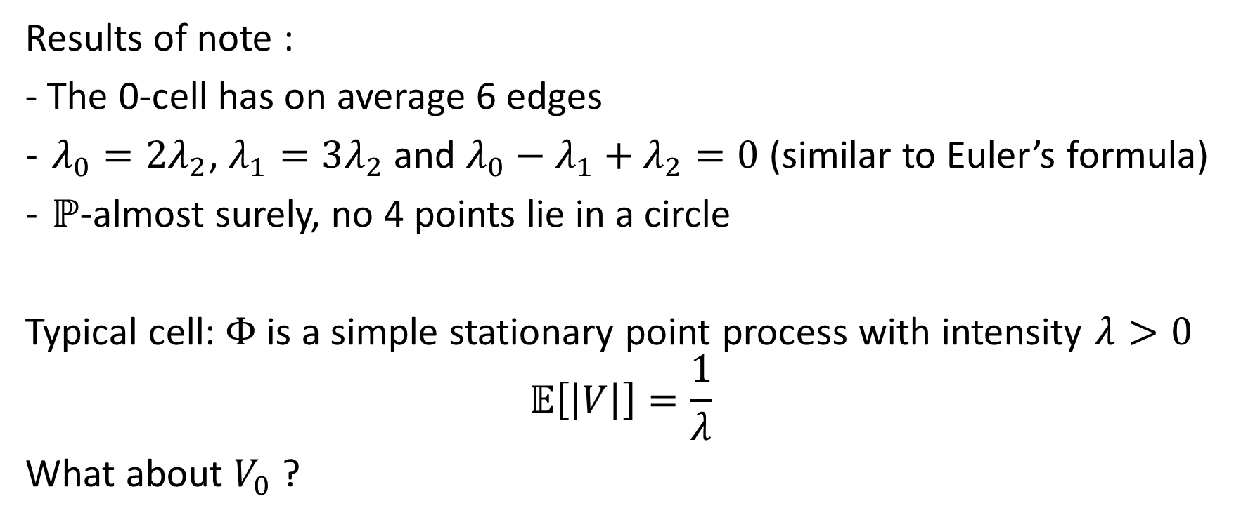
Typical cell vs 0-cell
Results of note :
- The 0-cell has on average 6 edges
$λ_{0}=2λ_{2}$, $λ_{1}=3λ_{2}$ and $λ_{0}−λ_{1}+λ_{2}=0$ (similar to Euler’s formula)
$ℙ$-almost surely, no 4 points lie in a circle
Typical cell: $Φ$ is a simple stationary point process with intensity $λ>0$
$$𝔼\left[\left|V\right|\right]=\frac{1}{λ}$$
What about $V_{0}$ ?

Slide 12
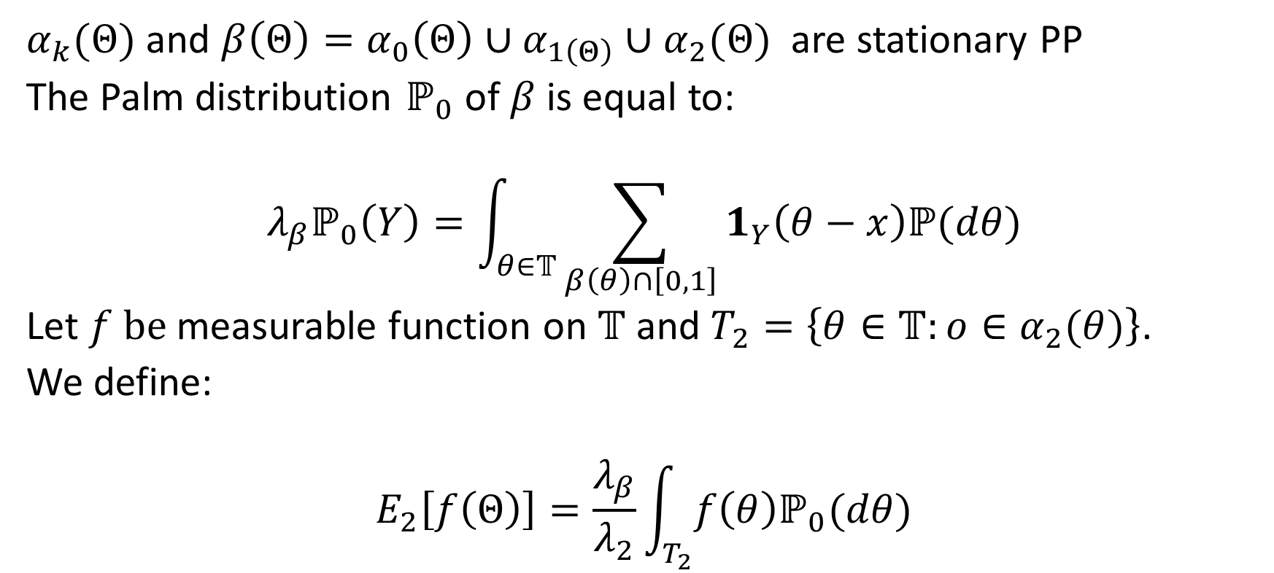
Typical cell vs 0-cell
$α_{k}(Θ)$ and $β\left(Θ\right)=α_{0}\left(Θ\right)∪α_{1\left(Θ\right)}∪α_{2}(Θ)$ are stationary PP
The Palm distribution $ℙ_{0}$ of $β$ is equal to:
$$λ_{β}ℙ_{0}\left(Y\right)=\int_{θ∈𝕋}{\sum_{β\left(θ\right)∩\left[0,1\right]}{1_{Y}\left(θ−x\right)ℙ(dθ)}}$$
Let $f be$ measurable function on $𝕋$ and $T_{2}=\left\{θ∈𝕋:o∈α_{2}(θ)\right\}$.
We define:
$$E_{2}\left[f\left(Θ\right)\right]=\frac{λ_{β}}{λ_{2}}\int_{T_{2}}{f\left(θ\right)ℙ_{0}(dθ)}$$

Slide 13
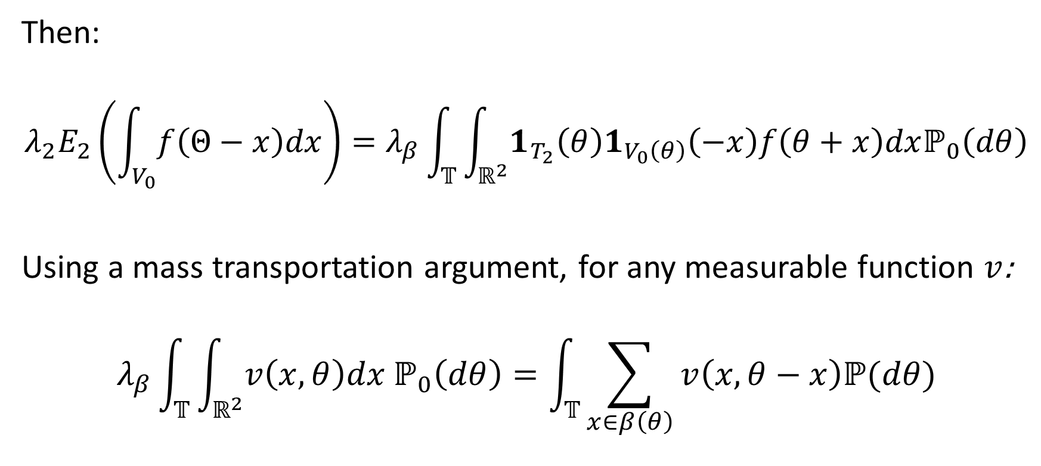
Typical cell vs 0-cell
Then:
$$λ_{2}E_{2}\left(\int_{V_{0}}{f\left(Θ−x\right)dx}\right)=λ_{β}\int_{𝕋}{\int_{ℝ^{2}}{1_{T_{2}}\left(θ\right)1_{V_{0}\left(θ\right)}\left(−x\right)f\left(θ+x\right)dxℙ_{0}\left(dθ\right)}}$$
Using a mass transportation argument, for any measurable function $v$:
$$λ_{β}\int_{𝕋}{\int_{ℝ^{2}}{v\left(x,θ\right)dx ℙ_{0}\left(dθ\right)}=\int_{𝕋}{\sum_{x∈β\left(θ\right)}{v\left(x,θ−x\right)ℙ(dθ)}}}$$

Slide 14
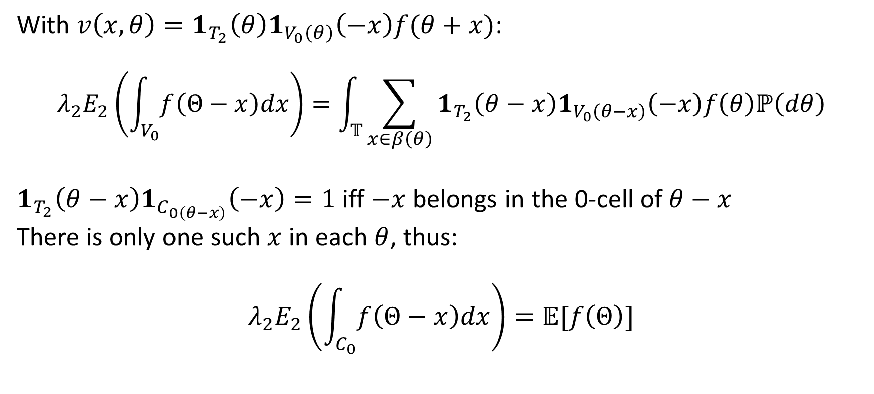
Typical cell vs 0-cell
With $v\left(x,θ\right)=1_{T_{2}}\left(θ\right)1_{V_{0}\left(θ\right)}\left(−x\right)f(θ+x)$:
$$λ_{2}E_{2}\left(\int_{V_{0}}{f\left(Θ−x\right)dx}\right)=\int_{𝕋}{\sum_{x∈β\left(θ\right)}{1_{T_{2}}\left(θ−x\right)1_{V_{0}\left(θ−x\right)}\left(−x\right)f\left(θ\right)ℙ\left(dθ\right)}}$$
$1_{T_{2}}\left(θ−x\right)1_{C_{0\left(θ−x\right)}}\left(−x\right)=1$ iff $−x$ belongs in the 0-cell of $θ−x$
There is only one such $x$ in each $θ$, thus:
$$λ_{2}E_{2}\left(\int_{C_{0}}{f\left(Θ−x\right)dx}\right)=𝔼[f\left(Θ\right)]$$

Slide 15
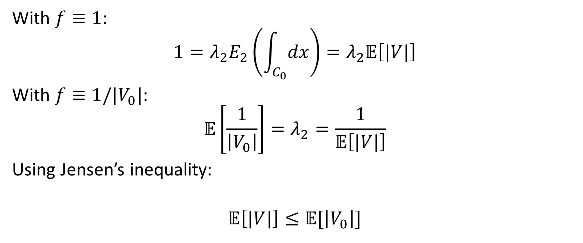
Typical cell vs 0-cell
With $f≡1$:
$$1=λ_{2}E_{2}\left(\int_{C_{0}}{dx}\right)=λ_{2}𝔼\left[|V|\right]$$
With $f≡1/|V_{0}|$:
$$𝔼\left[\frac{1}{\left|V_{0}\right|}\right]=λ_{2}=\frac{1}{𝔼\left[|V|\right]}$$
Using Jensen’s inequality:
$$𝔼\left[|V|\right]≤𝔼[\left|V_{0}\right|]$$
Feller’s paradox

Slide 16
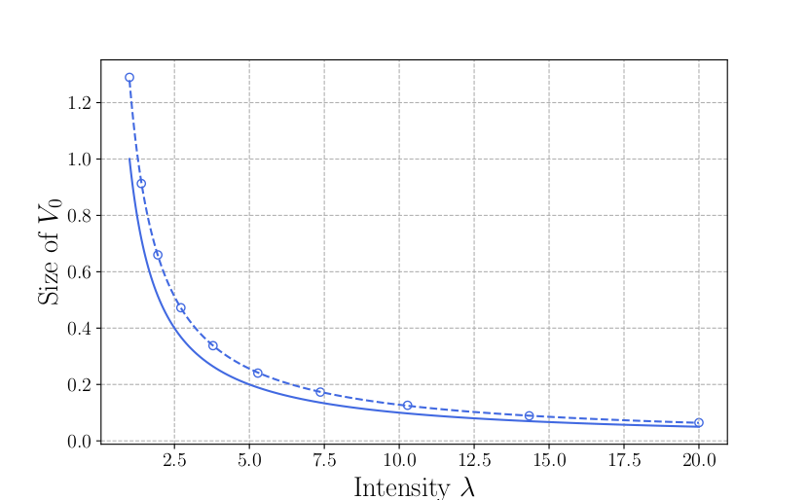
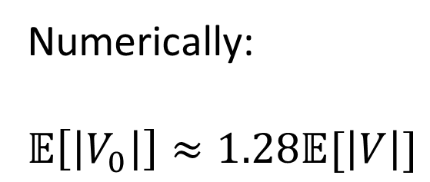
Typical cell vs 0-cell
Numerically:
$$𝔼\left[\left|V_{0}\right|\right]≈1.28𝔼[\left|V\right|]$$

Slide 17
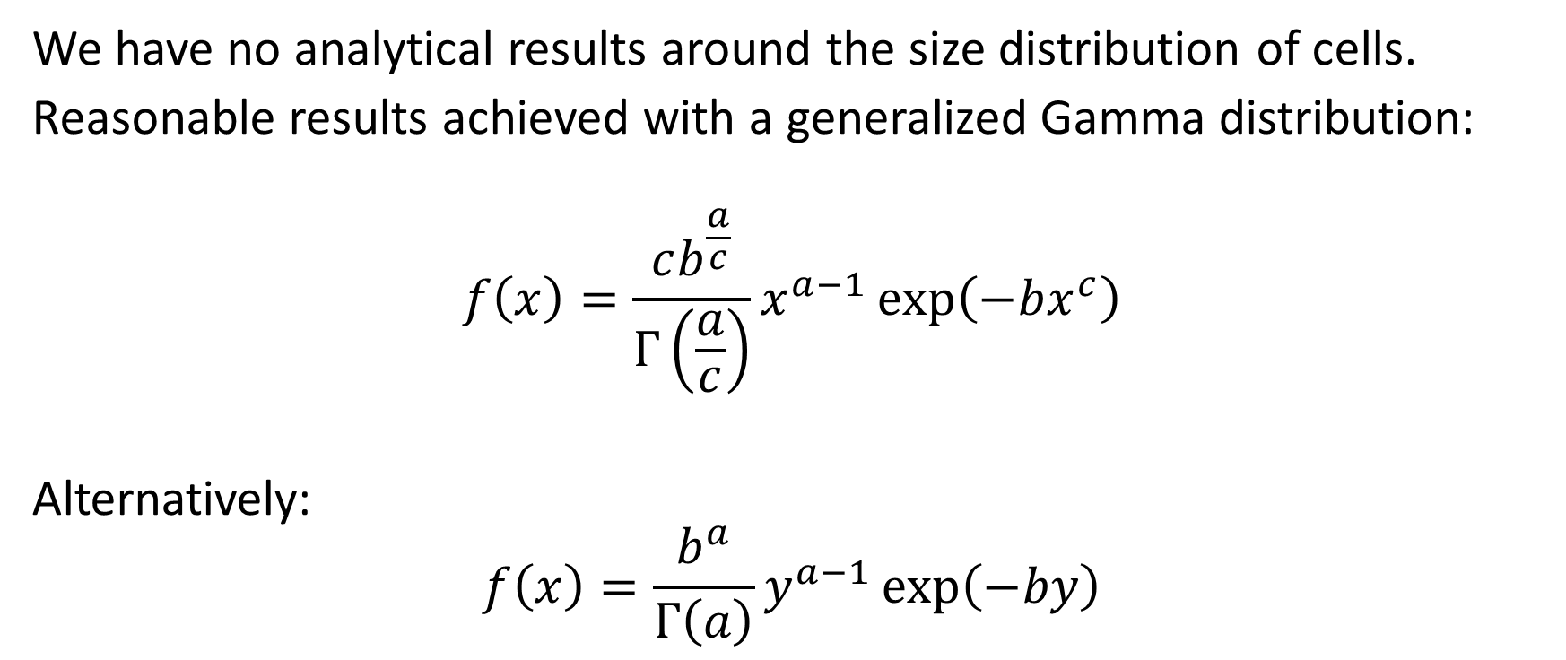
Size distribution of PV cells
We have no analytical results around the size distribution of cells.
Reasonable results achieved with a generalized Gamma distribution:
$$f\left(x\right)=\frac{cb^{\frac{a}{c}}}{Γ\left(\frac{a}{c}\right)}x^{a−1}\exp\left(−bx^{c}\right)$$
Alternatively:
$$f\left(x\right)=\frac{b^{a}}{Γ\left(a\right)}y^{a−1}\exp\left(−by\right)$$

Slide 18
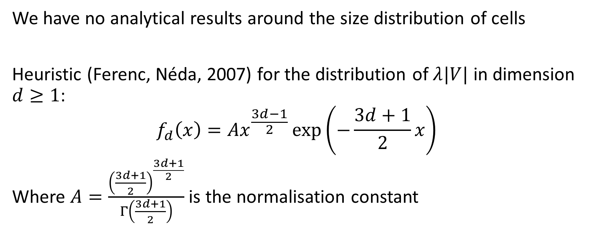
Size distribution of PV cells
We have no analytical results around the size distribution of cells
Heuristic (Ferenc, Néda, 2007) for the distribution of $λ|V|$ in dimension $d≥1$:
$$f_{d}\left(x\right)=Ax^{\frac{3d−1}{2}}\exp\left(−\frac{3d+1}{2}x\right)$$
Where $A=\frac{{\left(\frac{3d+1}{2}\right)}^{\frac{3d+1}{2}}}{Γ\left(\frac{3d+1}{2}\right)}$ is the normalisation constant

Slide 19
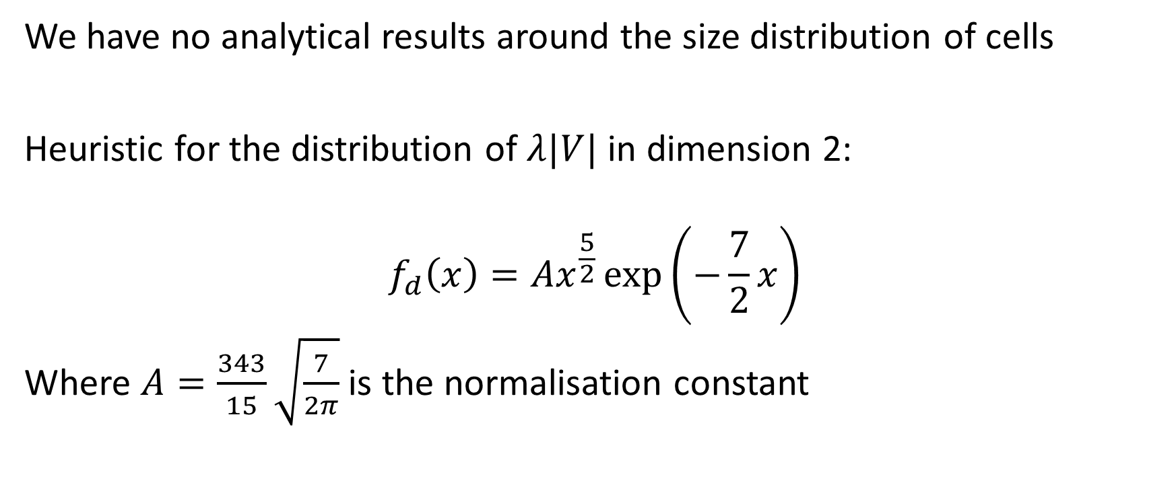
Size distribution of PV cells
We have no analytical results around the size distribution of cells
Heuristic for the distribution of $λ|V|$ in dimension 2:
$$f_{d}\left(x\right)=Ax^{\frac{5}{2}}\exp\left(−\frac{7}{2}x\right)$$
Where $A=\frac{343}{15}\sqrt{\frac{7}{2π}}$ is the normalisation constant

Slide 20
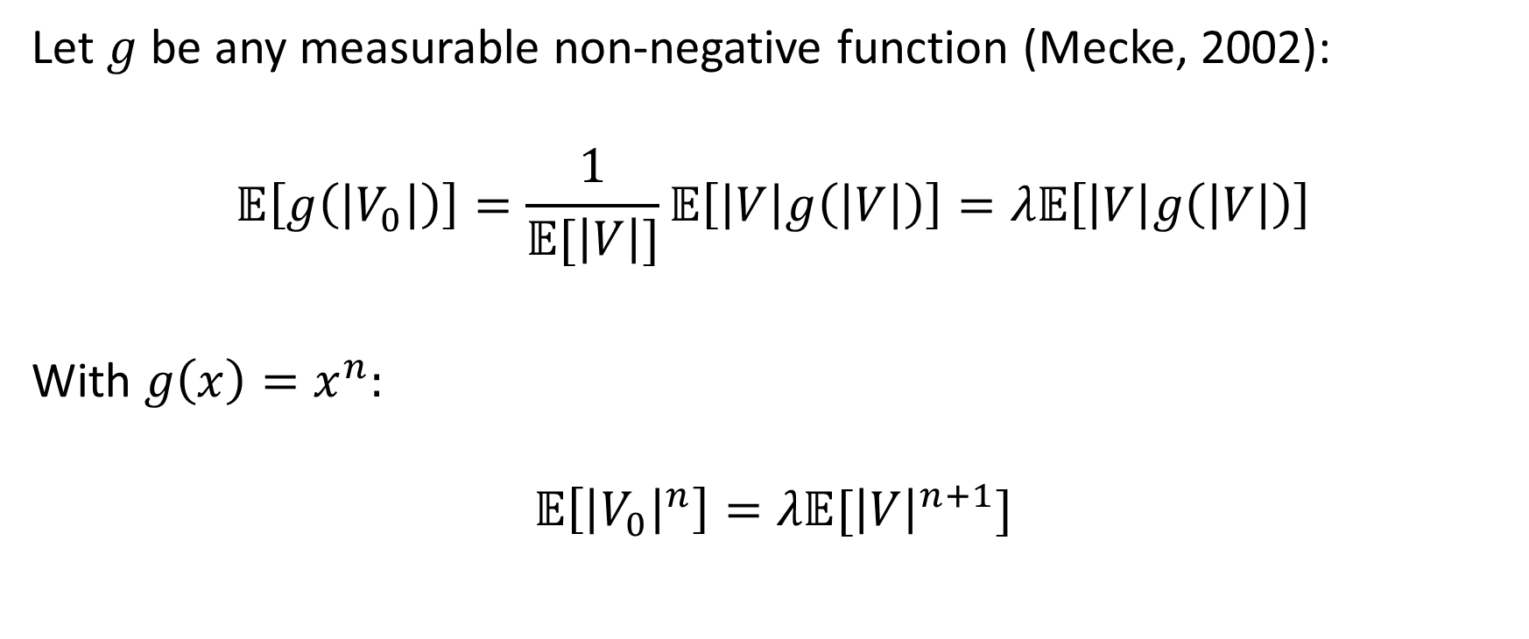
Results around the 0-cell
Let $g$ be any measurable non-negative function (Mecke, 2002):
$$𝔼\left[g\left(\left|V_{0}\right|\right)\right]=\frac{1}{𝔼[\left|V\right|]}𝔼\left[\left|V\right|g\left(\left|V\right|\right)\right]=λ𝔼\left[\left|V\right|g\left(\left|V\right|\right)\right]$$
With $g\left(x\right)=x^{n}:$
$$𝔼\left[{\left|V_{0}\right|}^{n}\right]=λ𝔼[{\left|V\right|}^{n+1}]$$

Slide 21
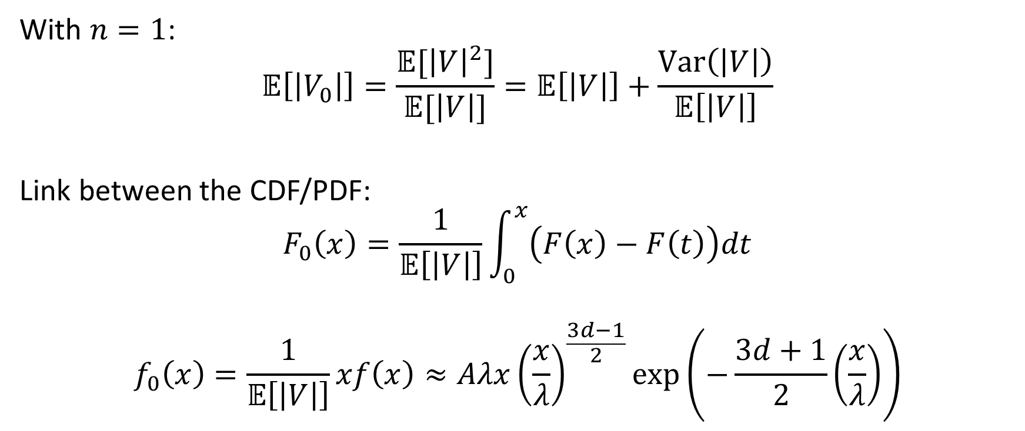
Results around the 0-cell
With $n=1$:
$$𝔼\left[\left|V_{0}\right|\right]=\frac{𝔼[{\left|V\right|}^{2}]}{𝔼[\left|V\right|]}=𝔼\left[\left|V\right|\right]+\frac{Var\left(\left|V\right|\right)}{𝔼\left[\left|V\right|\right]}$$
Link between the CDF/PDF:
$$F_{0}\left(x\right)=\frac{1}{𝔼\left[\left|V\right|\right]}\int_{0}^{x}{\left(F\left(x\right)−F\left(t\right)\right)dt}$$
$$f_{0}\left(x\right)=\frac{1}{𝔼\left[\left|V\right|\right]}xf\left(x\right)≈Aλx{\left(\frac{x}{λ}\right)}^{\frac{3d−1}{2}}\exp\left(−\frac{3d+1}{2}\left(\frac{x}{λ}\right)\right)$$

Slide 22

Results around the 0-cell
Size of the 0-cell with $d=2$:
$$𝔼\left[\left|V_{0}\right|\right]=\int_{0}^{∞}{xf_{0}\left(x\right)dx=}\frac{9}{7}\frac{1}{λ}≈1.28𝔼[\left|V\right|]$$
This result is only a heuristic, no analytical result exists

Slide 23
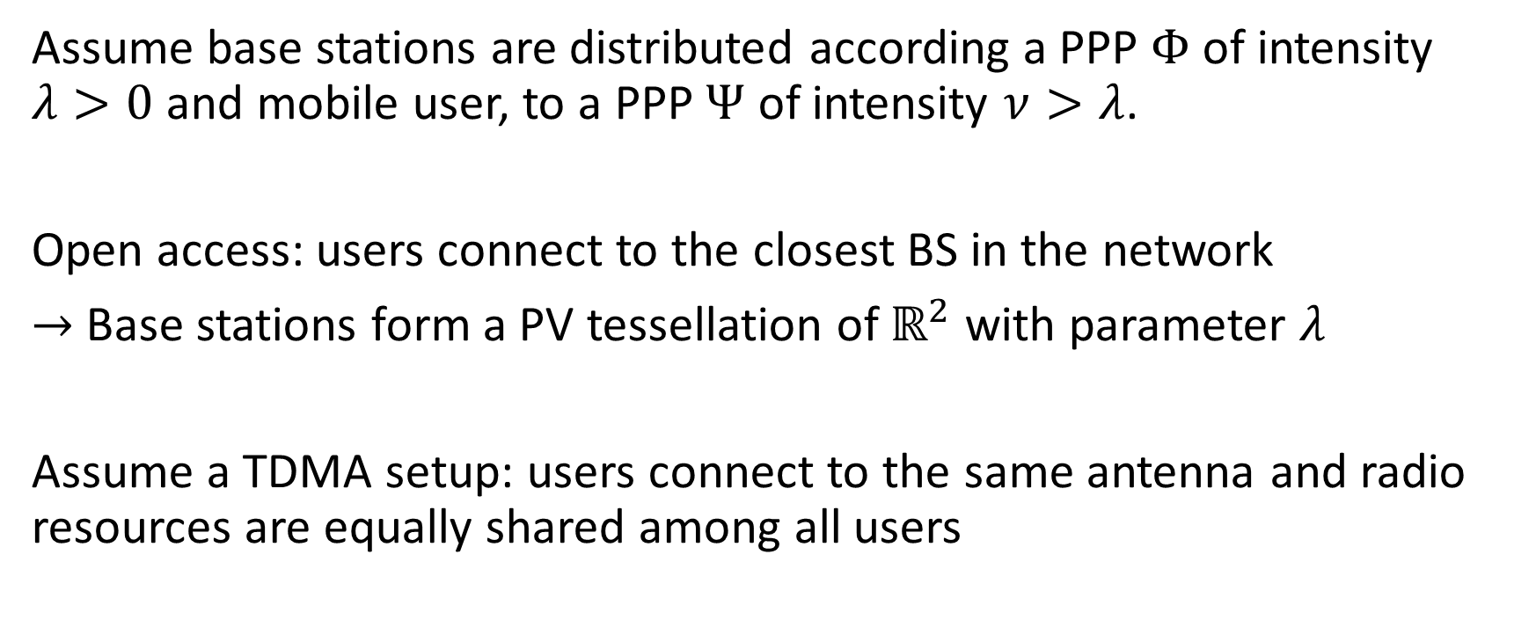
Practical example – wireless network
Assume base stations are distributed according a PPP $Φ$ of intensity $λ>0$ and mobile user, to a PPP $Ψ$ of intensity $ν>λ$.
Open access: users connect to the closest BS in the network
$→$ Base stations form a PV tessellation of $ℝ^{2}$ with parameter $λ$
Assume a TDMA setup: users connect to the same antenna and radio resources are equally shared among all users

Slide 24
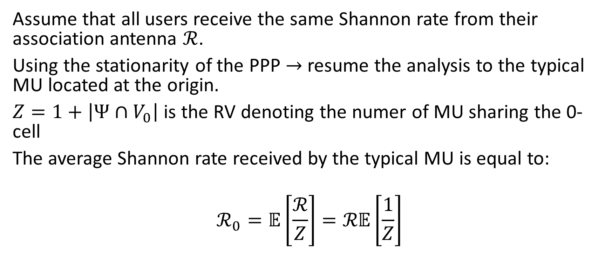
Practical example – wireless network
Assume that all users receive the same Shannon rate from their association antenna $ℛ$.
Using the stationarity of the PPP $→$ resume the analysis to the typical MU located at the origin.
$Z=1+\left|Ψ∩V_{0}\right|$ is the RV denoting the numer of MU sharing the 0-cell
The average Shannon rate received by the typical MU is equal to:
$$ℛ_{0}=𝔼\left[\frac{ℛ}{Z}\right]=ℛ𝔼\left[\frac{1}{Z}\right]$$

Slide 25
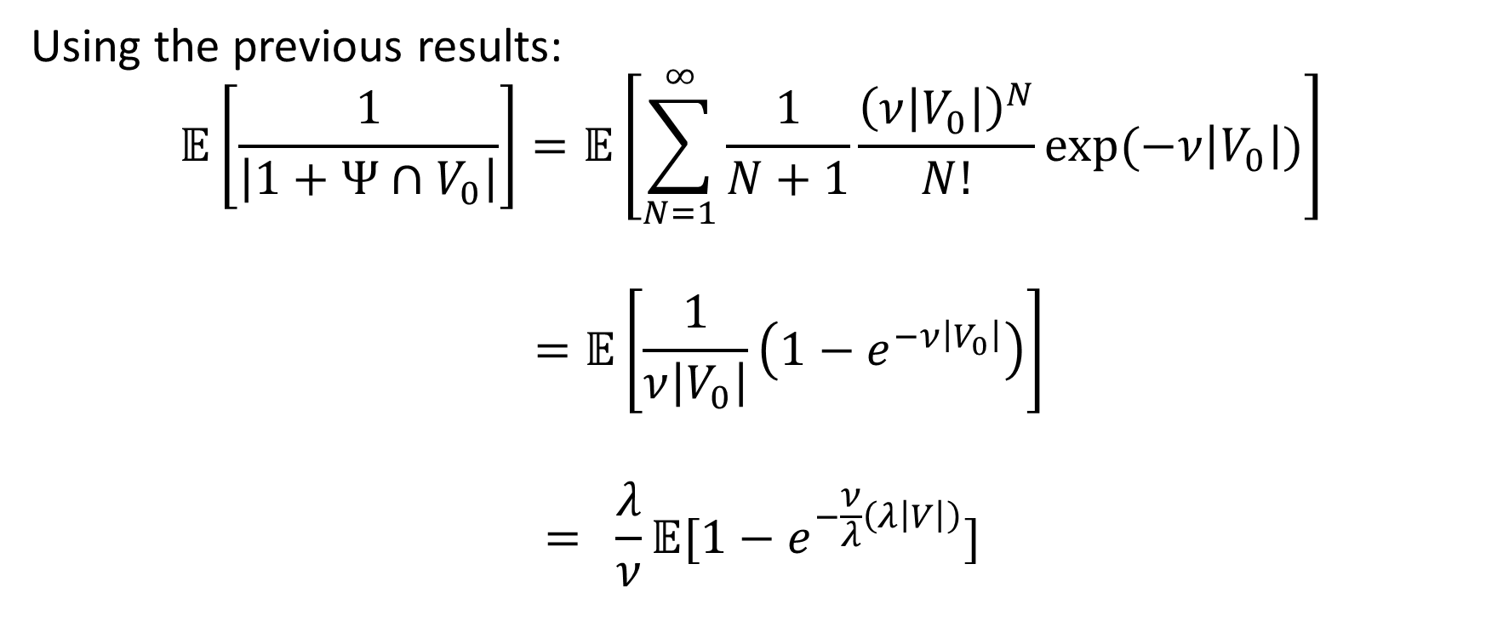
Practical example – wireless network
Using the previous results:
$$𝔼\left[\frac{1}{\left|1+Ψ∩V_{0}\right|}\right]=𝔼\left[\sum_{N=1}^{∞}{\frac{1}{N+1}}\frac{{\left(ν\left|V_{0}\right|\right)}^{N}}{N!}exp⁡(−ν\left|V_{0}\right|)\right]$$
$$=𝔼\left[\frac{1}{ν\left|V_{0}\right|}\left(1−e^{−ν\left|V_{0}\right|}\right)\right]$$
$$= \frac{λ}{ν}𝔼[1−e^{−\frac{ν}{λ}\left(λ\left|V\right|\right)}]$$

Slide 26
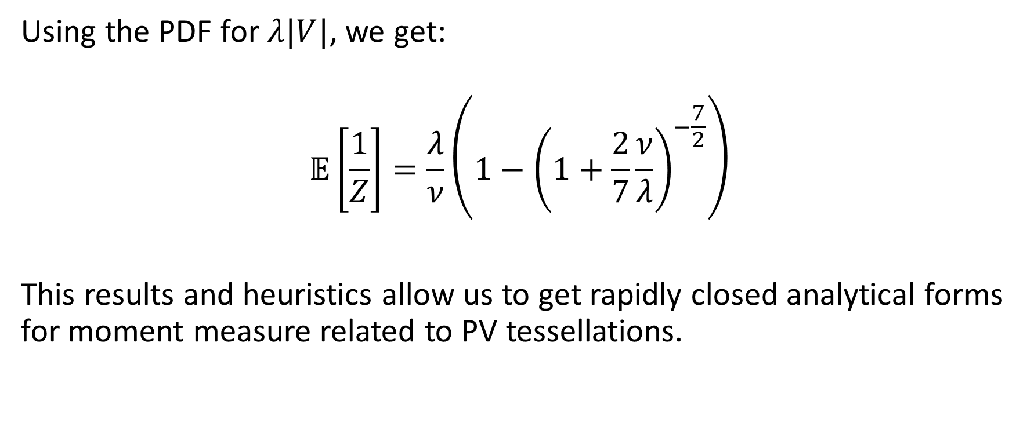
Practical example – wireless network
Using the PDF for $λ|V|$, we get:
$$𝔼\left[\frac{1}{Z}\right]=\frac{λ}{ν}\left(1−{\left(1+\frac{2}{7}\frac{ν}{λ}\right)}^{−\frac{7}{2}}\right)$$
This results and heuristics allow us to get rapidly closed analytical forms for moment measure related to PV tessellations.

Slide 27
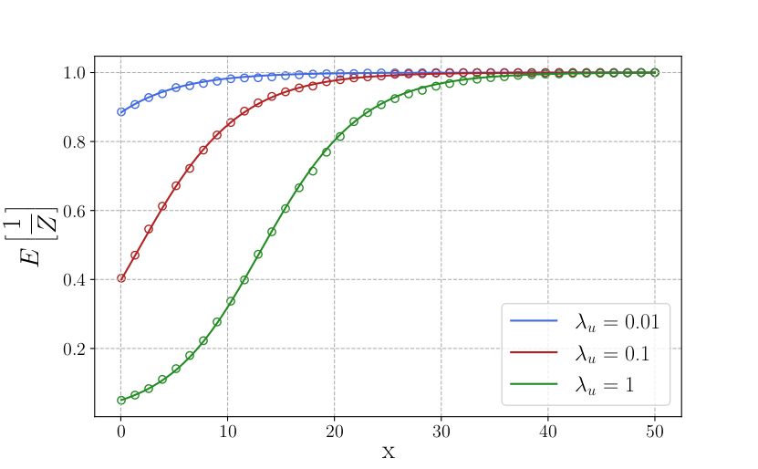
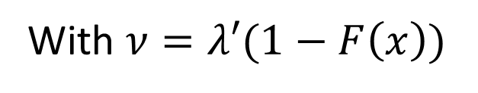
Practical example – wireless network
With $ν=λ′(1−F\left(x\right))$

Slide 28
References
Baccelli, Blaszczyszyn, Karray, Random Measures, Point Processes, and Stochastic Geometry, Inria, 2020
Chiu, Stoyan, Mecke, Kendall, Mecke, Stochastic Geometry and its Applications, Wiley, 2013
Mecke, On the relationship between the 0-cell and the typical cell of a stationary random tessellation, 1998
Ferenc, Néda, On the size distribution of Poisson Voronoi cells, 2007
Mankar, Parida, Dhillon, Haenggi, Distance from the Nucleus to a Uniformly Random Point in the 0-cell and the Typical Cell of the Poisson-Voronoi Tessellation, 2019

Slide 29
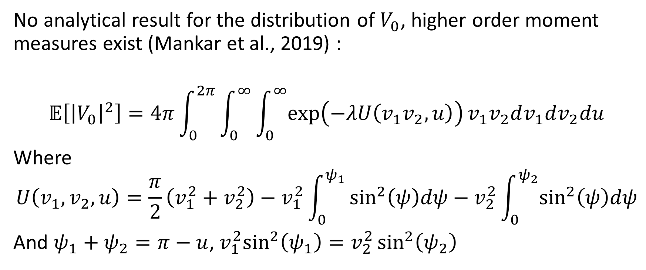
Results around the 0-cell
No analytical result for the distribution of $V_{0}$, higher order moment measures exist (Mankar et al., 2019) :
$$𝔼\left[{\left|V_{0}\right|}^{2}\right]=4π\int_{0}^{2π}{\int_{0}^{∞}{\int_{0}^{∞}{\exp\left(−λU\left(v_{1}v_{2},u\right)\right)v_{1}v_{2}dv_{1}dv_{2}du}}}$$
Where
$$U\left(v_{1},v_{2},u\right)=\frac{π}{2}\left(v_{1}^{2}+v_{2}^{2}\right)−v_{1}^{2}\int_{0}^{ψ_{1}}{\sin^{2}\left(ψ\right)dψ−v_{2}^{2}\int_{0}^{ψ_{2}}{\sin^{2}\left(ψ\right)dψ}}$$
And $ψ_{1}+ψ_{2}=π−u$, $v_{1}^{2}\sin^{2}\left(ψ_{1}\right)=v_{2}^{2}\sin^{2}\left(ψ_{2}\right)$

