Slide 1
Design of algorithms for the production of training data
LINCS Reading Group
Élie de Panafieu, Quentin Lutz, Alex Scott and Maya Stein
02-09-2020

Slide 2
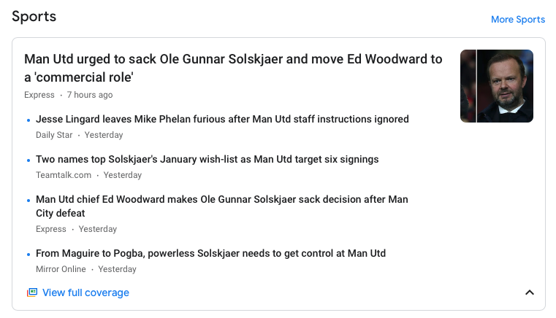
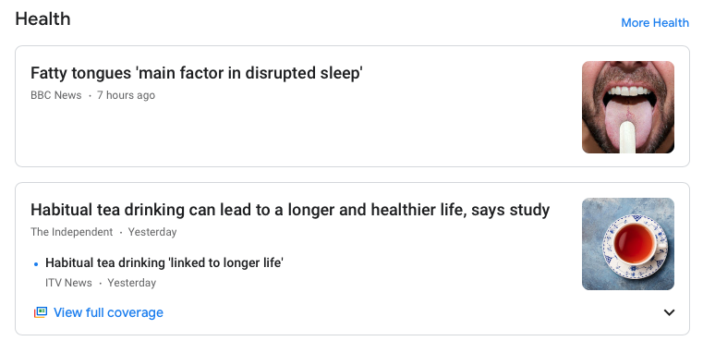
Motivation
ML perks
With the development of artificial intelligence, a number of tasks have proven to be automatable.

Slide 3
Motivation
Shortcomings
State-of-the-art methods make it possible to perform a wide range of tasks using large annotated datasets for training.
Such datasets are generally not available though pretrained models often suffice
However, the results given by pretrained state-of-the-art tools may be lacking in some situations.
To succeed, building a large labeled set of documents is of particular interest.

Slide 4






Motivation
Need for training sets
Building annotated sets is an important topic in the industry
Many companies focus on this objective:

Slide 5
Motivation
Document classification
Annotation or labeling is equivalent to classification.
Classification task: Group and label a set of documents (text, images, etc.)
Clustering task: Same thing, without the labels
Sports
Politics
Health

Slide 6
Motivation
Human-based classification
Without ML techniques, some human-made classification seems necessary at some point given the nature of the data. However,
  There are lots of documents
  The experts need to be trained/briefed beforehand
  There may be many classes to know
Maria Laura Maag’s point: We ask the experts to compare pairs of items (pairwise queries) rather than to classify each item individually.
The main point to be tackled there is to reduce the cost of experts spending time on that task.
We thus optimize the requests to be answered by the experts using graph theory.

Slide 7
Graph formalism
Construction
Starting from a graph with no edges, the experts can unveil the correlation between two nodes.
My sound has been disabled.
I can’t access my mailbox.
Pressing the power button results in a loud screeching sound.
?
Audio is not working on my computer.
Outlook is broken.

Slide 8
Graph formalism
Construction
When two items are known to be in the same class, a number of questions become superfluous:
Cluster 1
My sound has been disabled.
I can’t access my mailbox.
Pressing the power button results in a loud screeching sound.
Audio is not working on my computer.
Outlook is broken.

Slide 9
Graph formalism
Construction
Knowing clusters makes it possible to infer some of the links:
Cluster 1
My sound has been disabled.
I can’t access my mailbox.
?
Pressing the power button results in a loud screeching sound.
Audio is not working on my computer.
Outlook is broken.

Slide 10
Graph formalism
Construction
Knowing clusters makes it possible to infer some of the links:
Cluster 1
My sound has been disabled.
I can’t access my mailbox.
Pressing the power button results in a loud screeching sound.
Audio is not working on my computer.
Outlook is broken.

Slide 11
Graph formalism
Construction
Knowing clusters makes it possible to infer some of the links:
Cluster 1
My sound has been disabled.
I can’t access my mailbox.
Pressing the power button results in a loud screeching sound.
Audio is not working on my computer.
Outlook is broken.

Slide 12
Graph formalism
Construction
A cluster is a new node in the aggregated graph
Cluster 1
My sound has been disabled.
I can’t access my mailbox.
Pressing the power button results in a loud screeching sound.
Audio is not working on my computer.
Outlook is broken.

Slide 13
Graph formalism
Construction
Cluster 1
My sound has been disabled.
I can’t access my mailbox.
?
Pressing the power button results in a loud screeching sound.
Audio is not working on my computer.
Outlook is broken.

Slide 14
Graph formalism
Construction
Cluster 1
My sound has been disabled.
I can’t access my mailbox.
Pressing the power button results in a loud screeching sound.
Audio is not working on my computer.
Outlook is broken.

Slide 15
Graph formalism
Construction
Cluster 1
My sound has been disabled.
I can’t access my mailbox.
Pressing the power button results in a loud screeching sound.
?
Audio is not working on my computer.
Outlook is broken.

Slide 16
Graph formalism
Construction
Cluster 1
Cluster 2
My sound has been disabled.
I can’t access my mailbox.
Pressing the power button results in a loud screeching sound.
Audio is not working on my computer.
Outlook is broken.

Slide 17
Graph formalism
Construction
The final clustering is obtained when the aggregated graph is complete.
Cluster 1
Cluster 3
Cluster 2
My sound has been disabled.
I can’t access my mailbox.
Pressing the power button results in a loud screeching sound.
Audio is not working on my computer.
Outlook is broken.

Slide 18
Graph formalism
Discussion
We reduce the problem from classification to clustering
It may seem like we increase the number of questions to be asked but:
  It appears the experts would prefer comparing items in pairs
  It is possible to reduce the number of questions from a naive baseline
We may also partly rely on heuristics, though:
  They cannot be trusted entirely
  It should be possible to maintain strong guarantees while using them

Slide 19
Graph formalism
How to choose pairs
Asking questions changes the graph, here the graphs we went through are:
The main difficulty is choosing which edge to reveal as we do not know in advance if the nodes under study will be merged or linked.
merge
link
link
merge
link

Slide 20
Graph formalism
How to choose pairs, an example
What question should we ask first to ask the least number of questions on average?

Slide 21

Graph formalism
How to choose pairs, an example
$1.\frac{1}{5}+4.\frac{3}{5}=\frac{13}{5}$ questions

Slide 22

Graph formalism
How to choose pairs, an example
$3.\frac{2}{5}+2.\frac{3}{5}=\frac{12}{5}$ questions

Slide 23


Graph formalism
How to choose pairs, an example
$\frac{12}{5}$ questions
$\frac{13}{5}$ questions

Slide 24
Graph formalism
Relevant litterature
This problem has been described in the bioinformatics field as combinatorial search.
This problem is highly reminiscent of use cases in active learning, however:
Given the nature of the data, there are no reliable features or metrics that would enable a good self-assessment of AL tools.
Given this use case (i. e. building a training/validation set), we seek maximal accuracy hence human-driven classification.

Slide 25
Graph formalism
Problem
We are trying to solve:
An active clustering problem
With an unknown but supposedly large number of labels
Which lead to looking at pairwise comparisons
We thus developed an algorithm to find what pairs of items to chose at each step based on previous answers.

Slide 26
Chordal algorithms
Idea
We found that to ensure the mean cost is minimal translates nicely into preserving the chordality of the aggregated graph throughout the partition discovery.
A graph is chordal (or triangulated) if any cycle has a chord.
That property is easily checked at a low computational cost: a query ( u ,v ) is satisfactory whenever the intersection of the neighborhoods of u and v separate them.
It is possible to keep the graph chordal even with several experts working at once.

Slide 27
Chordal algorithms
Chordality leaves room for choice
There are many ways to keep the graph chordal at each step.
This allows for further optimizations to be made.
For instance, in order to really minimize the time spent by the experts rather than the number of questions, edges can be chosen to form a walk on the graph (one text in common between two consecutive queries).

Slide 28
Chordal algorithms
Chordality leaves room for heuristics
Thanks to the leeway that the chordality condition leaves, heuristics can be used while preserving theoretical guarantees.
Because we make pairwise comparisons rather than text classification, we are most interested in pairs of items in the same class because they reduce the number of questions to be asked for these items.
Heuristics can be used to find the “most promising” pairs of items, i. e. those that are most likely to belong to the same class.
In practice, this helps further reduce the number of questions to be asked.

Slide 29
Chordal algorithms
Trusting heuristics
A more aggressive algorithm could take the confidence placed in heuristics into account to avoid asking ”easy” question to humans.
Such heuristics could also learn along the clustering process to improve their accuracy on-the-fly.
On the one hand, this could drastically reduce the time spent by the experts on a dataset.
On the other hand, this could yield poor results if confidence in heuristics is misplaced.
There is a need for an easily adjustable balance between those two extremes.

Slide 30
Further improvements
Non-trivial partition distributions
We conjecture that the distribution of the number of questions asked is the same for all chordal algorithms. What about the distribution of the partitions that can be found within a given number of questions?
The current formulation of the problem assumes that the partition of the set is chosen uniformly at random.
If one has insider information that may favor some partitions, how should the algorithm be modified to use it?

Slide 31
Further improvements
Allowing for error correction
In order to enable error correction in that context, we must choose additional comparisons.
There is no absolute answer depending on how many mistakes the experts make.
However, graph theory still provides relevant metrics to assess the quality of the partition discovery (robustness of the graph).

Slide 32
References
Bouvel M., Grebinski V., Kucherov G. (2005) Combinatorial Search on Graphs Motivated by Bioinformatics Applications: A Brief Survey. In: Kratsch D. (eds) Graph-Theoretic Concepts in Computer Science. WG 2005. Lecture Notes in Computer Science, vol 3787. Springer, Berlin, Heidelberg. https://doi.org/10.1007/11604686_2

